Slide 1
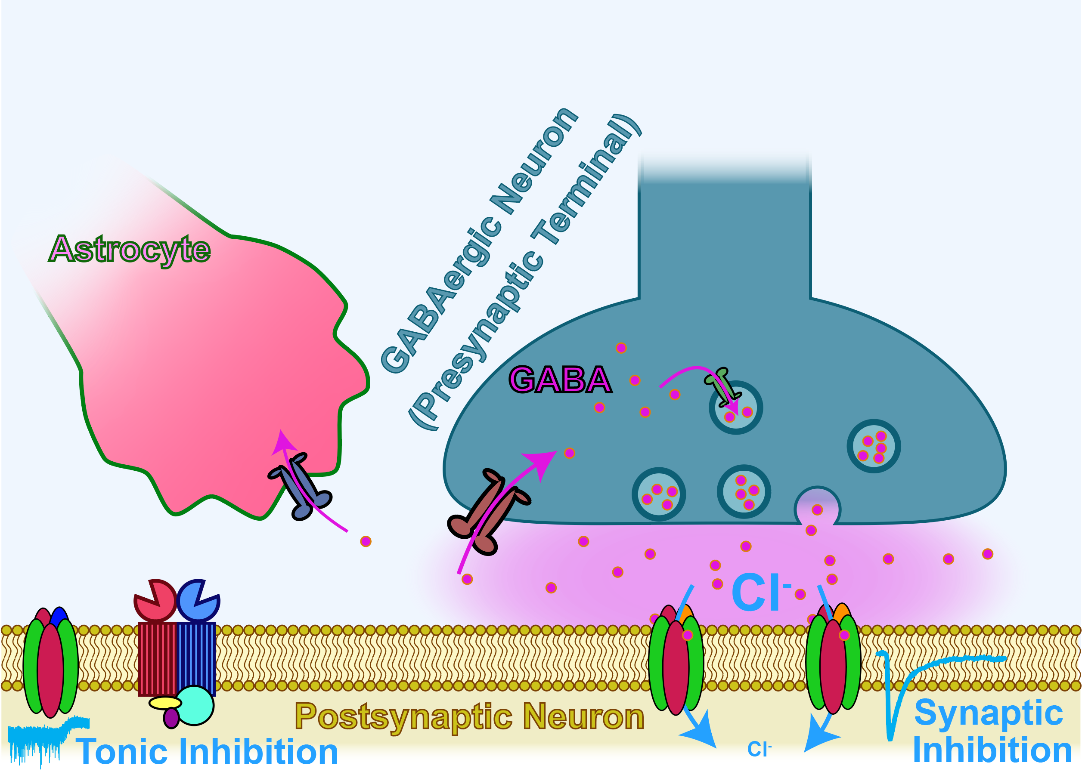

GABAergic Neurotransmission with GAT-1(S295L) Variant
Vanderbilt University Medical Center
Department of Neurology
By Dr. Kirill Zavalin
Lab of Dr. Jing-Qiong Kang (Katty)
Vanderbilt University Medical Center

Slide 2
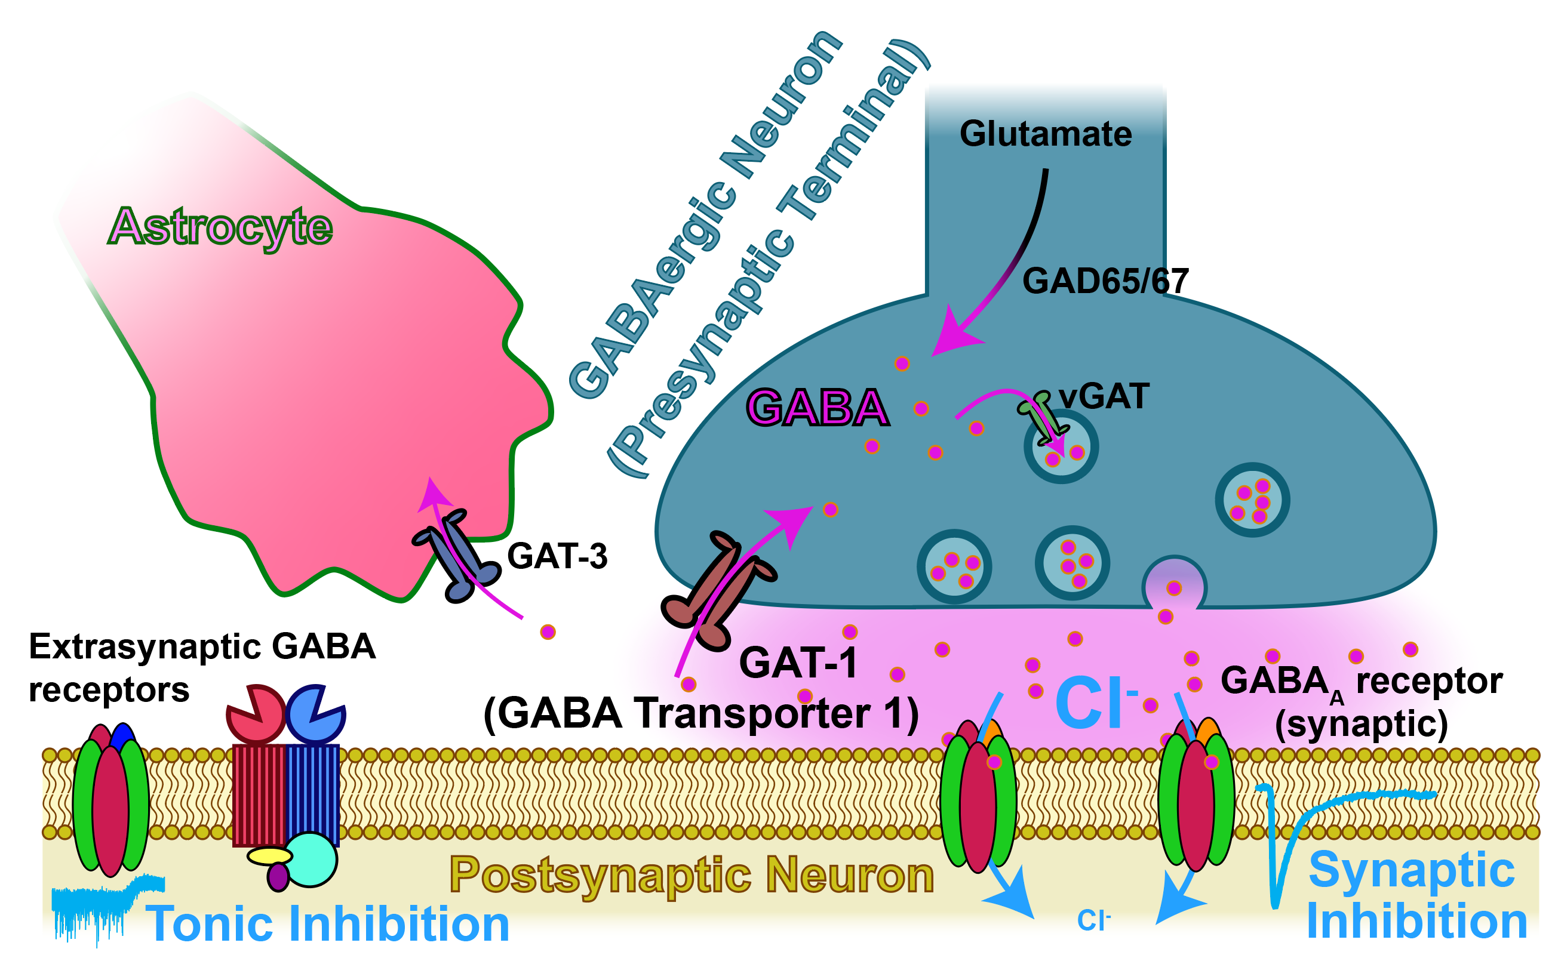
GAT-1 (Coded by SLC6A1) Is the Primary Transporter for Inhibitory Neurotransmitter GABA

Slide 3
Mutant Variants in SLC6A1 Are Associated with Neurologic and Developmental Disorders
DEE – developmental and epileptic encephalopathy

Slide 4
Mutant Variants in SLC6A1 Are Associated with Neurologic and Developmental Disorders
How is GABAergic neurotransmission changed in DEE associated with SLC6A1(S295L)?
DEE – developmental and epileptic encephalopathy

Slide 5
Slc6a1^{+/S295L} Knockin Mice Are an Animal Model for SLC6A1(S295L)-Associated DEE
DEE – developmental and epileptic encephalopathy

Slide 6
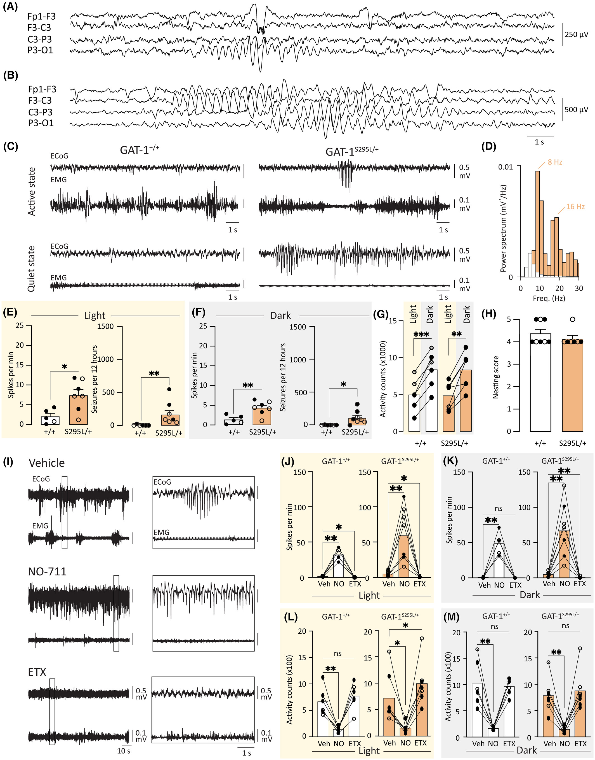
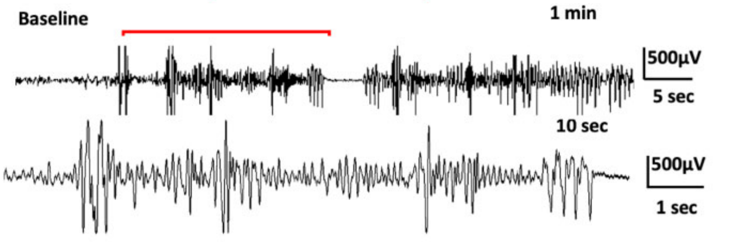
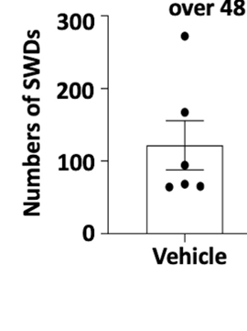
Slc6a1^{+/S295L} Mice Exhibit an Epileptic Phenotype with Absence-Type Seizures
Total 5-7 Hz Spike-Wave Discharges
Over 48 Hours
Britta E. Lindquist, Yuliya Voskobiynyk, Kimberly Goodspeed, and Jeanne T. Paz, 2023
Nwosu et al, 2022

Slide 7
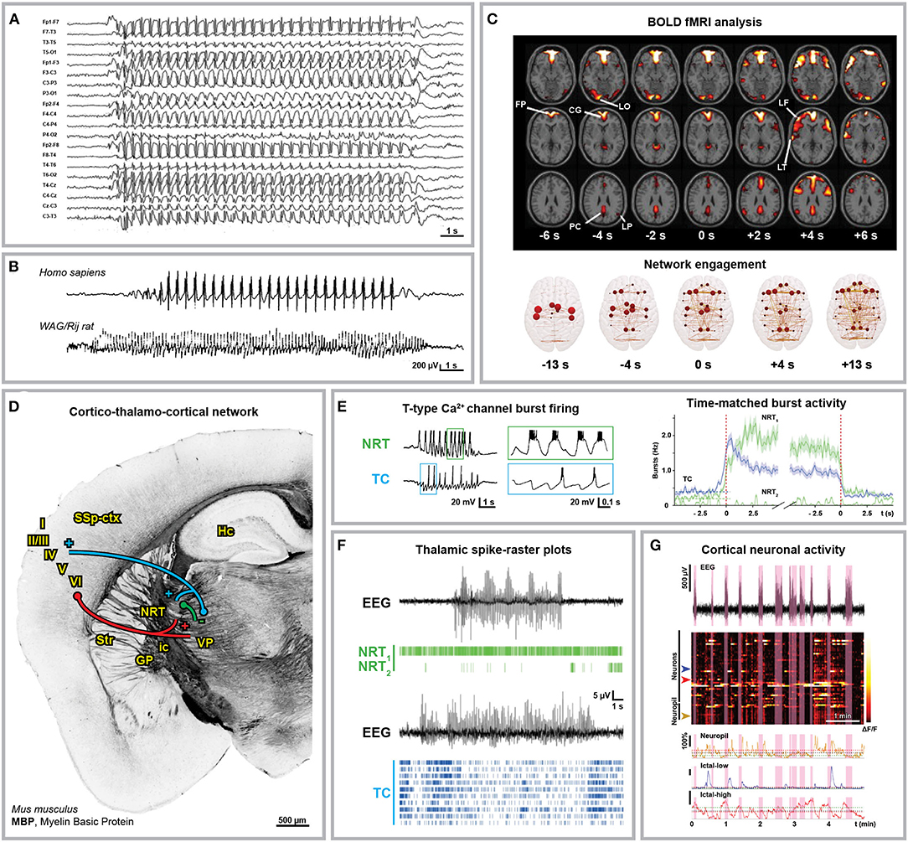
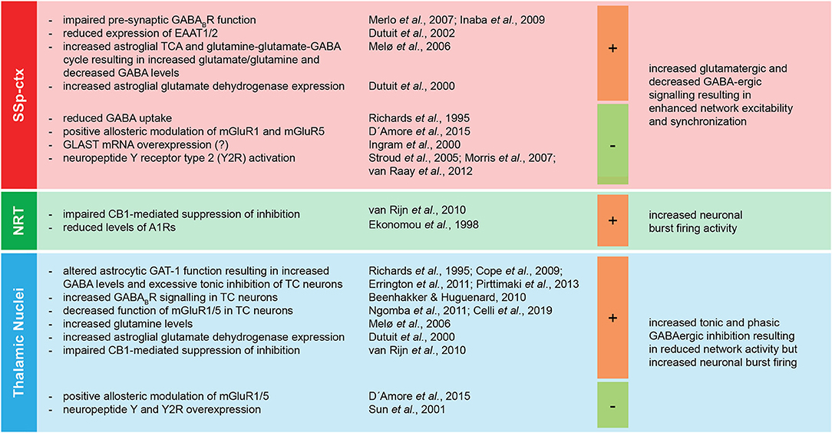
Cortex and Thalamus Are Two Crucial Regions in Absence Epilepsy
Gobbo et al, 2021

Slide 8
What Are the Pathologic Changes in GABAergic Neurotransmission with SLC6A1(S295L) DEE?
Normal
SLC6A1(S295L)
?

Slide 9
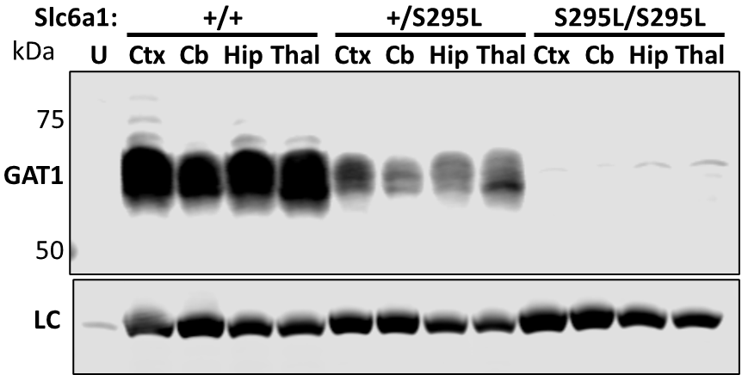
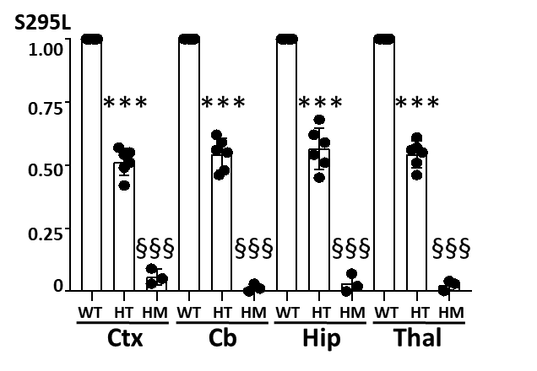
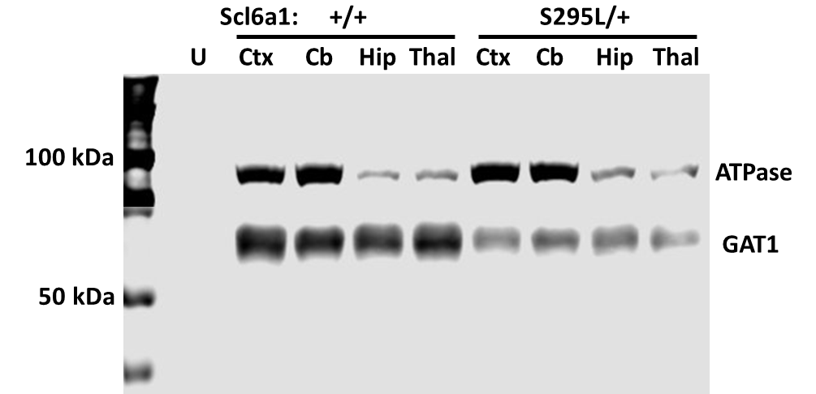
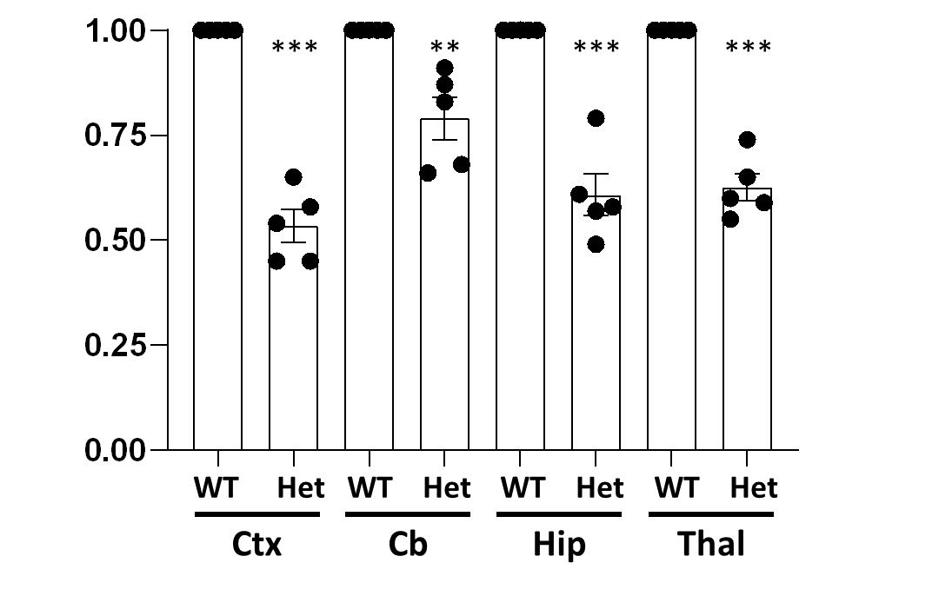
Reduced GAT-1 Expression in Slc6a1^{S295L} Mice
GAT-1 Expression
Normalized GAT-1 Protein
Slc6a1:
Surface GAT-1 Expression
Normalized Surface GAT-1 Protein
Slc6a1:
Work of Dr. Wangzhen Shen
WT: Slc6a1^{+/+}, HT: Slc6a1^{+/S295L}, HM: Slc6a1^{S295L/S295L}
Approximately 1 month old male mice were used in this study. Ctx: cortex, Cb: cerebellum, Hip: hippocampus, Thal: thalamus, U: untransfected Chinese Hamster Ovary cell line control. ATPase was used as loading control. ***,**,*P<.001, .01, .05 vs WT by t-test, respectively.
Notes:
Add partial LOF, complete LOF

Slide 10

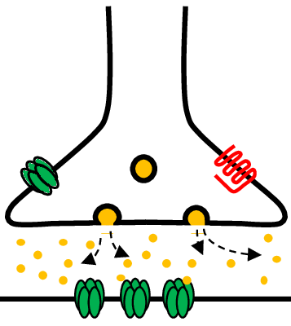

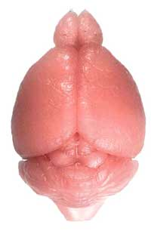
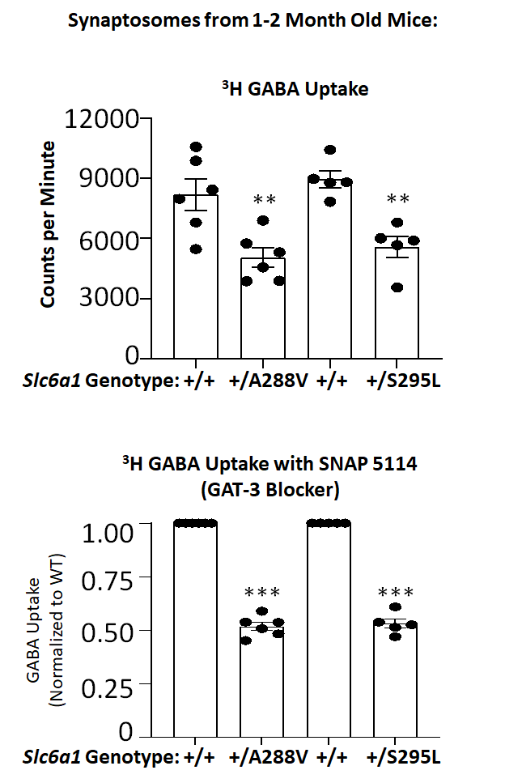
Reduced GABA Uptake in GAT-1 Variants
HEK Cells
Synaptosomes
^{from 1-2 month old mice}
H³ GABA Uptake
GAT-1: | WT | WT | WT | A288V/ WT | S295L/ WT | A288V/ A288V | S295L/ S295L
Drug: | None | Cl-966 | NNC-711 | None | None | None | None
Work of Felicia Mermer and Dr. Jingqiong Kang
Notes:
Add synaptosome data
Show synapse/mouse and dish to help visually

Slide 11
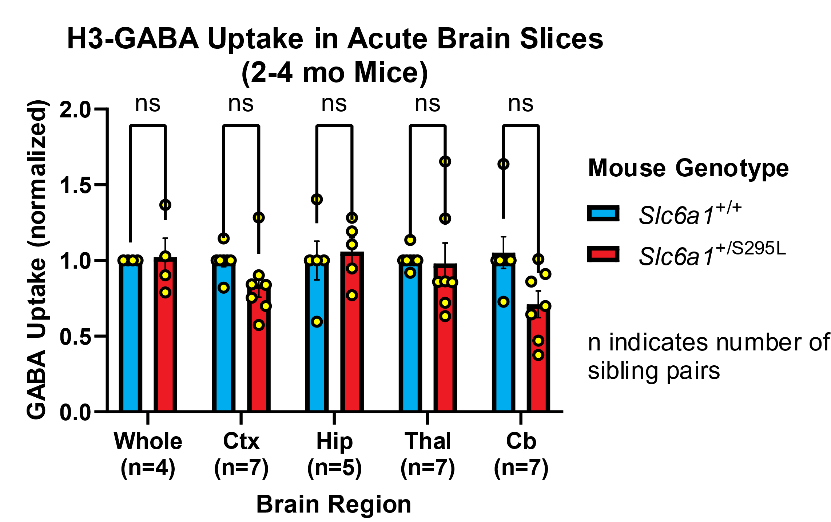
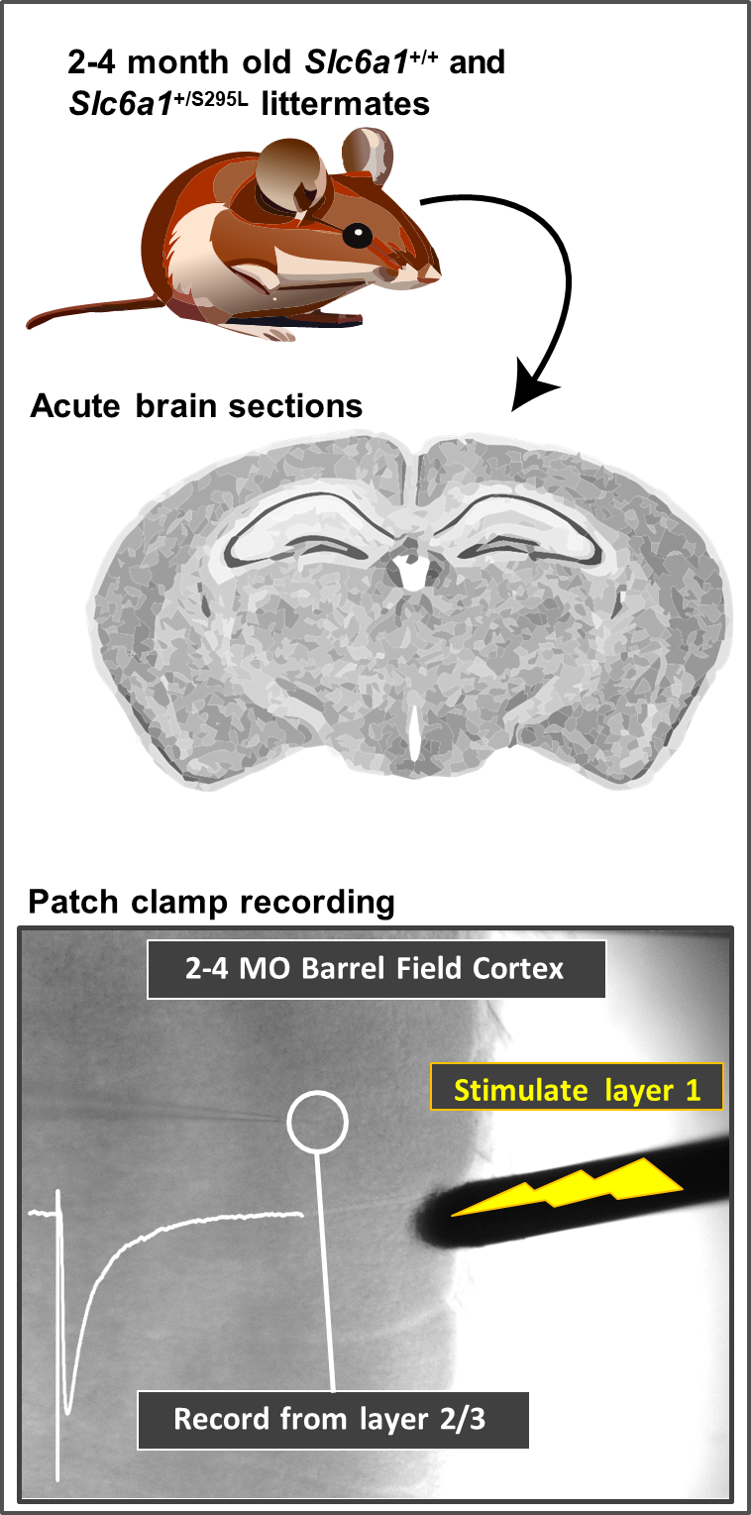
Trend for Reduced GABA Uptake in Cortex and Cerebellum
Graph shows mean with SEM with paired t-tests with Bonferroni corrections.

Slide 12
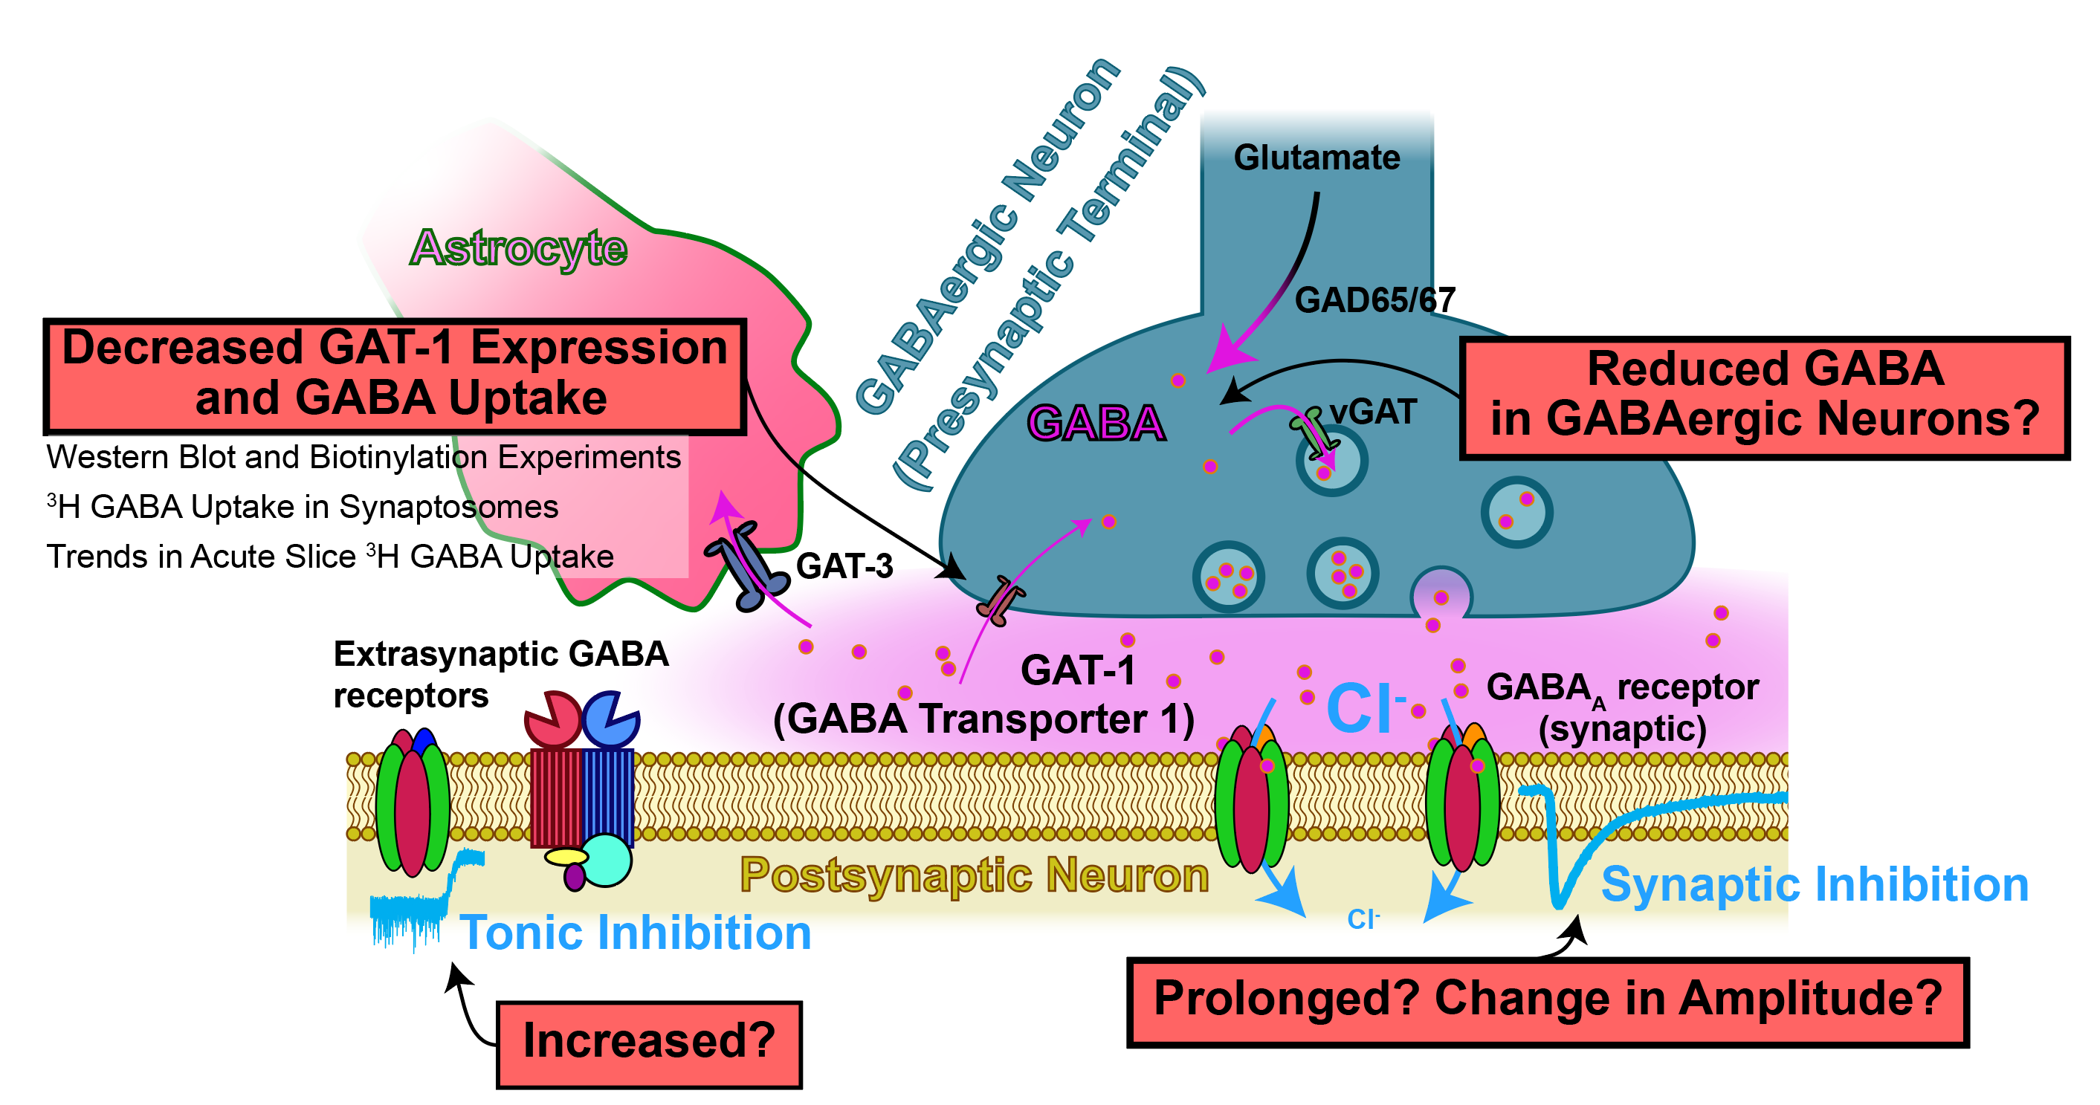
What Are the Pathologic Changes in GABAergic Neurotransmission with SLC6A1(S295L) DEE?
Normal
SLC6A1(S295L)

Slide 13
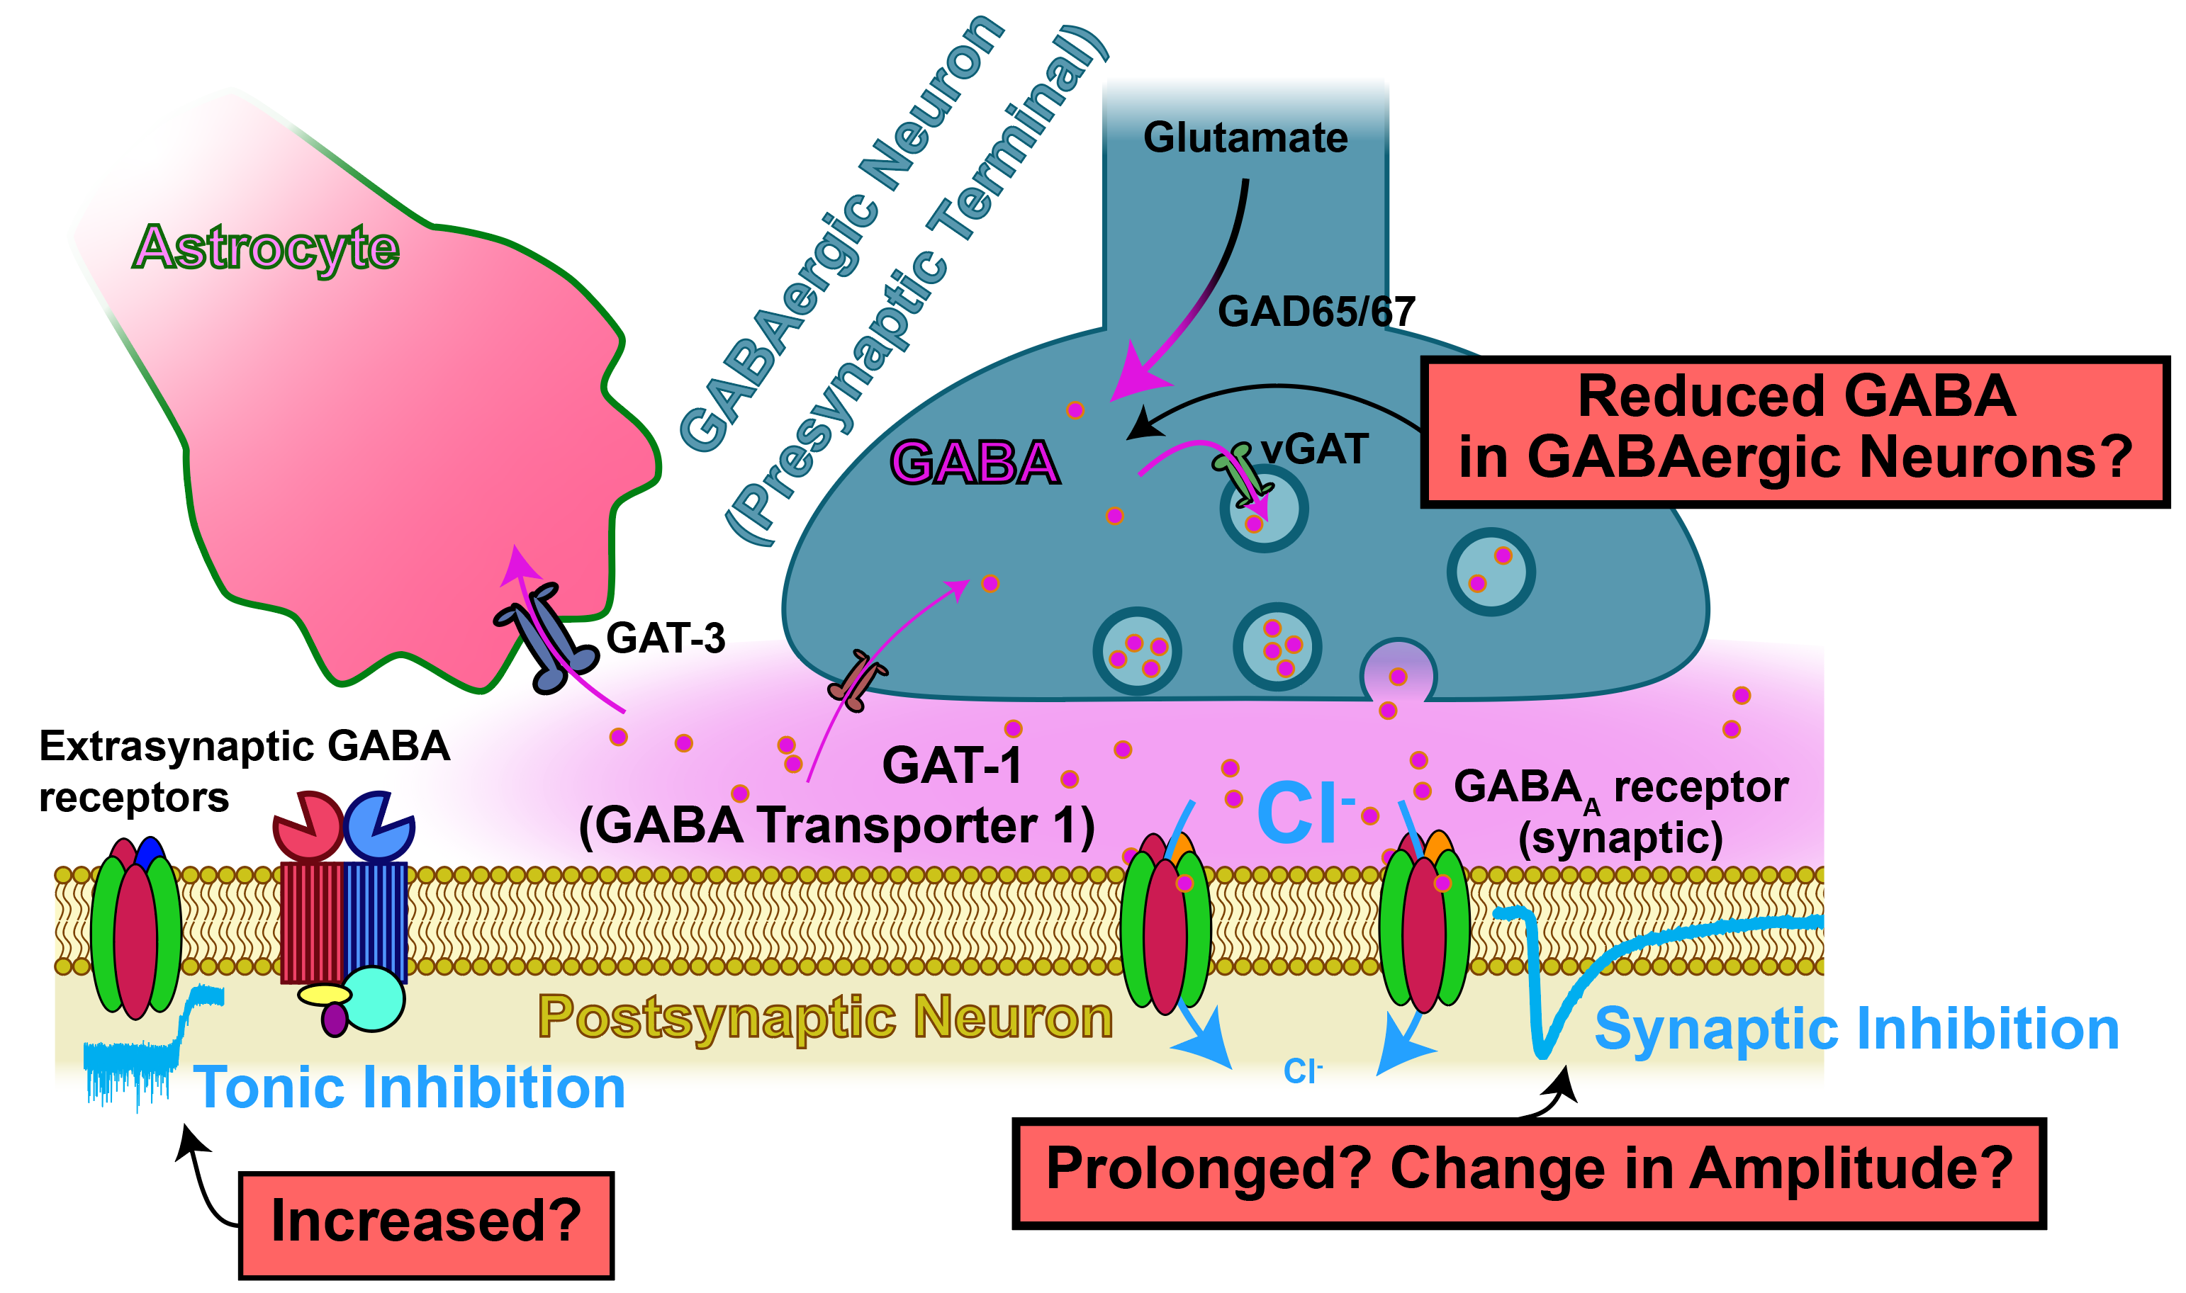
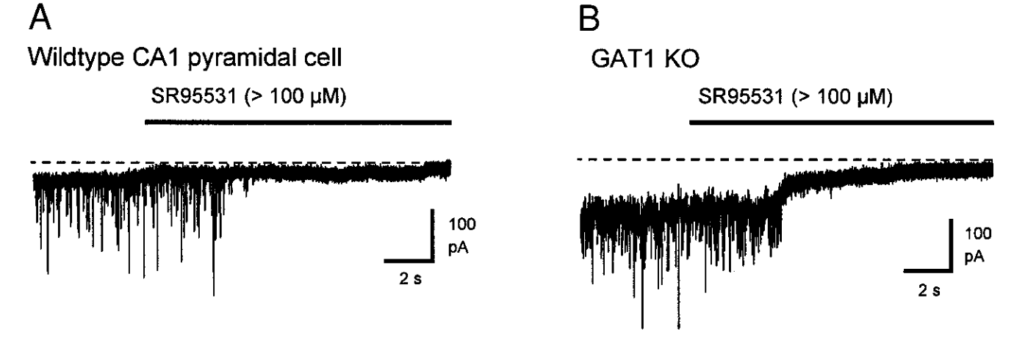
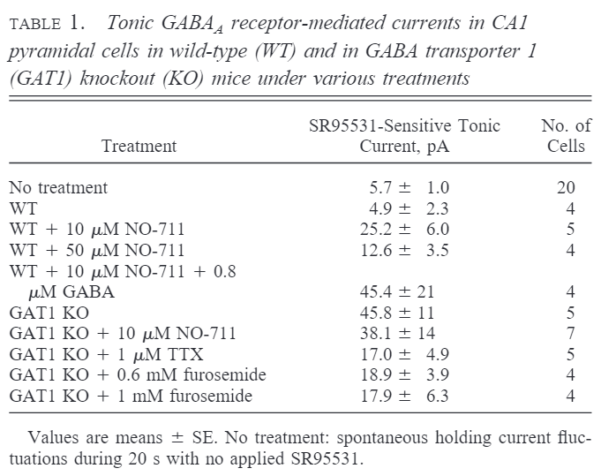
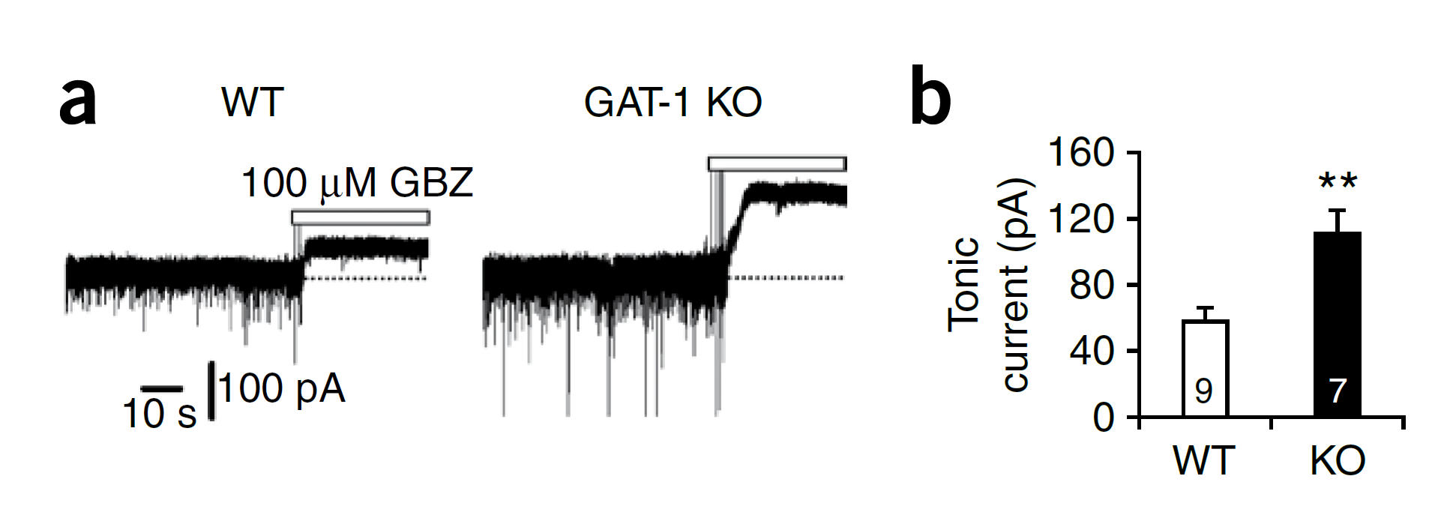
Increased Tonic GABAergic Current in Slc6a1 KO
Hippocampal CA1 pyramidal neurons in P15-25 Mice
Jensen et al, 2003 (Mody)
  Neurons in ventrobasal thalamus in P68-74 mice
Cope et al, 2009 (Crunelli)
Layer 3 cortical pyramidal neurons, 1-4 month old mice
Bragina et al, 2008 (Cherubini and Conti)

Slide 14
Increased Tonic GABAergic Current in Slc6a1 KO
Hippocampal CA1 pyramidal neurons in P15-25 Mice
Jensen et al, 2003 (Mody)
  Neurons in ventrobasal thalamus in P68-74 mice
Cope et al, 2009 (Crunelli)
Layer 3 cortical pyramidal neurons, 1-4 month old mice
Bragina et al, 2008 (Cherubini and Conti)

Slide 15
Increased Tonic GABAergic Current in Slc6a1 KO
Hippocampal CA1 pyramidal neurons in P15-25 Mice
Jensen et al, 2003 (Mody)
  Neurons in ventrobasal thalamus in P68-74 mice
Cope et al, 2009 (Crunelli)
Layer 3 cortical pyramidal neurons, 1-4 month old mice
Bragina et al, 2008 (Cherubini and Conti)

Slide 16
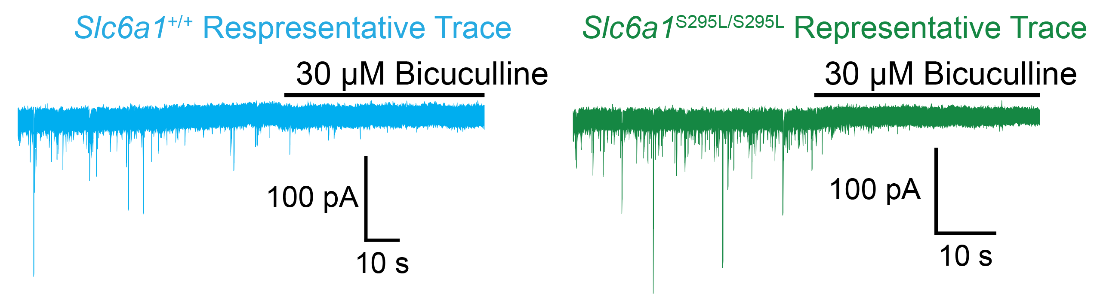
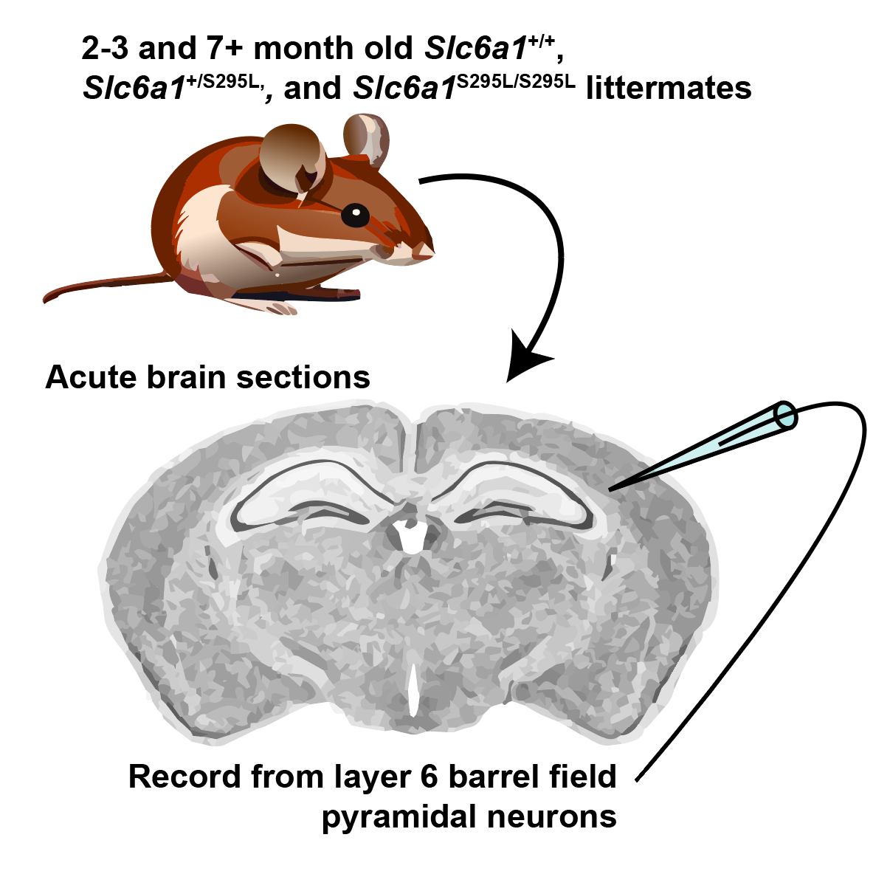
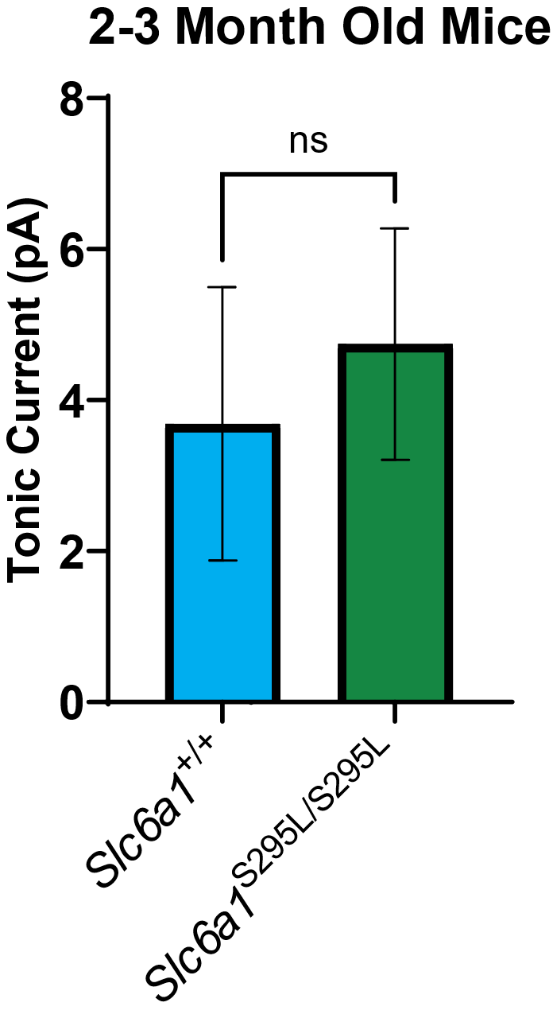
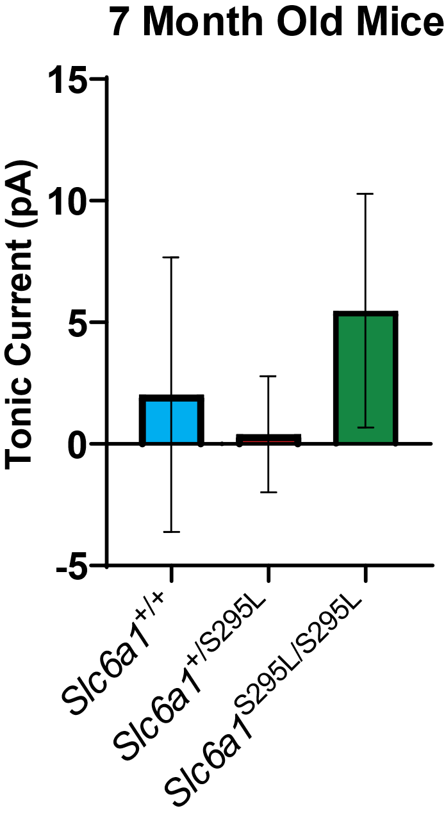
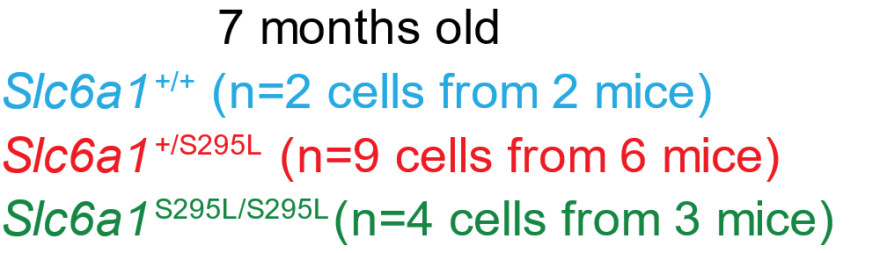
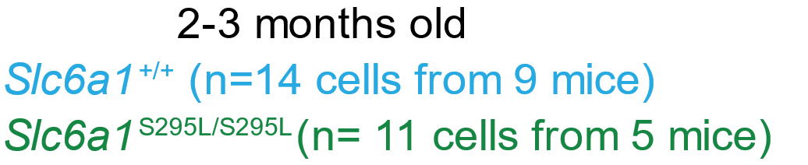
Negligible GABAergic Tonic Current in Slc6a1^{S295L/S295L} Cortex at 2-3 and 7+ Months Old
Graphs show mean with SEM with t-tests or ANOVA with Sidak’s posthoc.

Slide 17
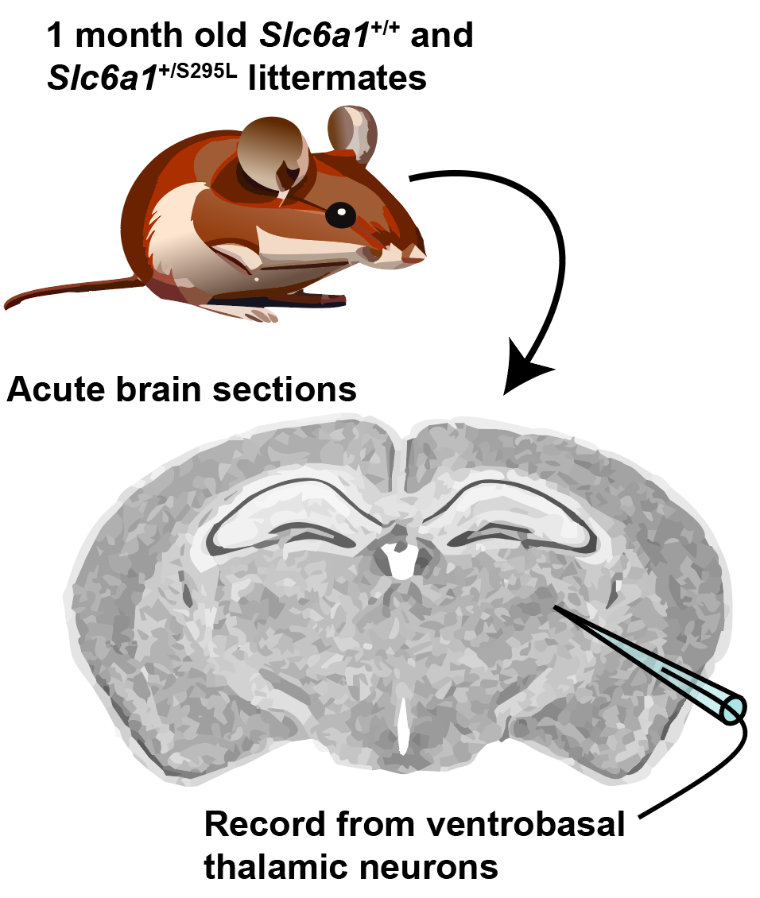
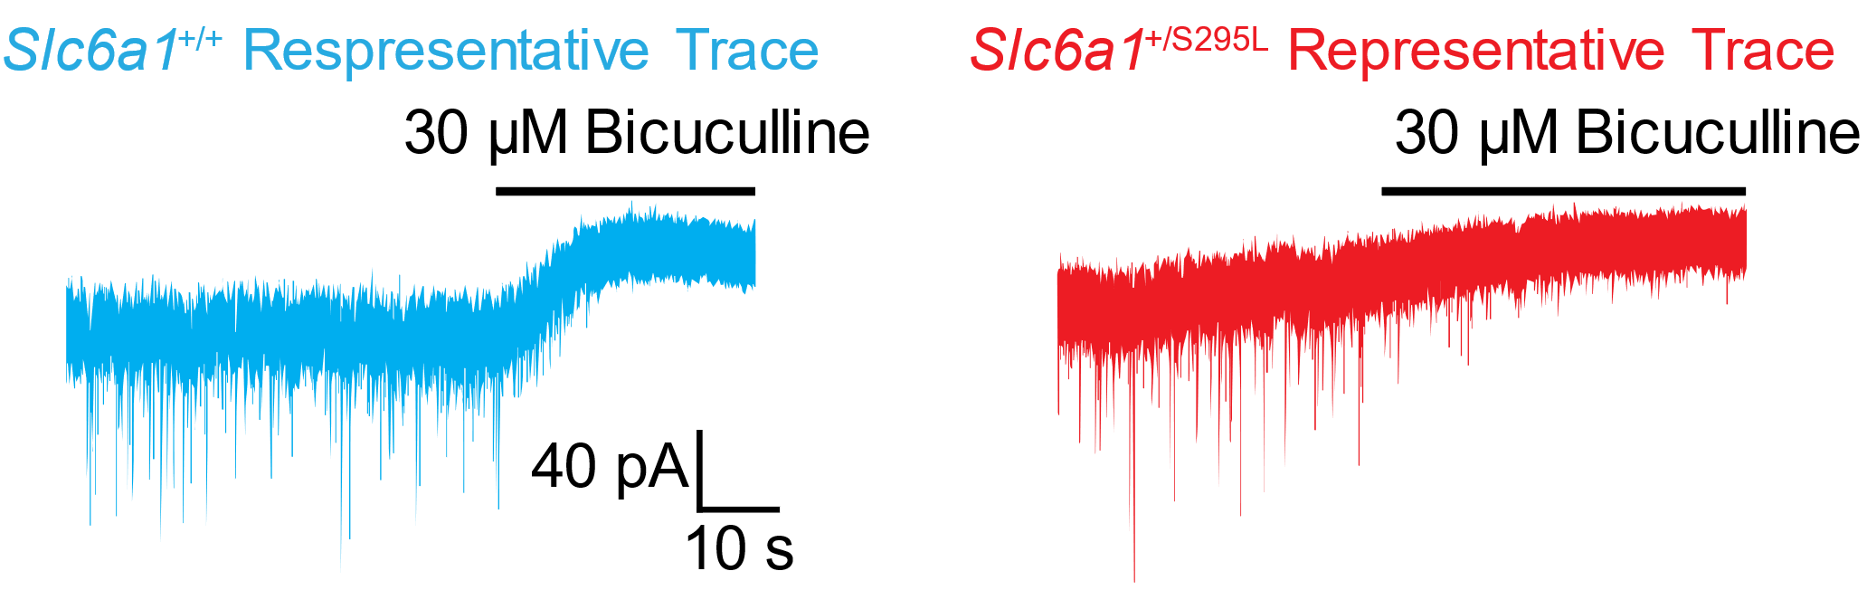
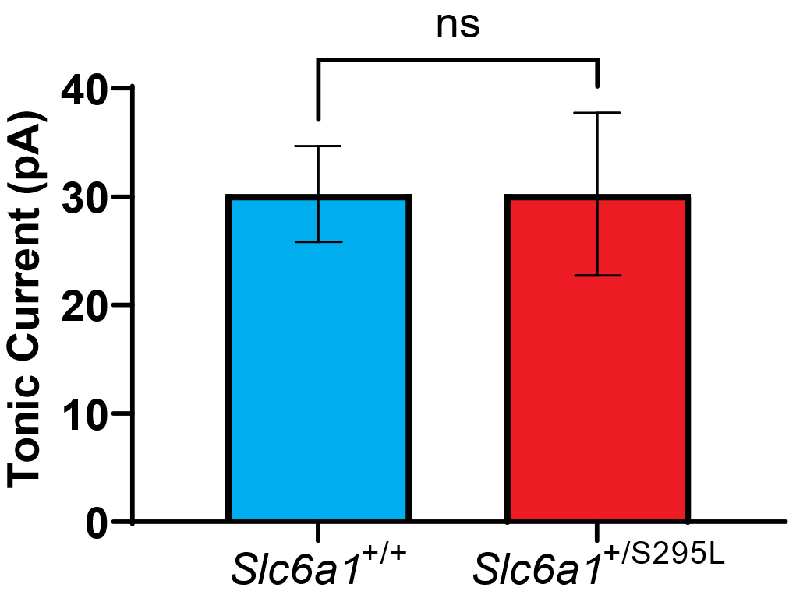
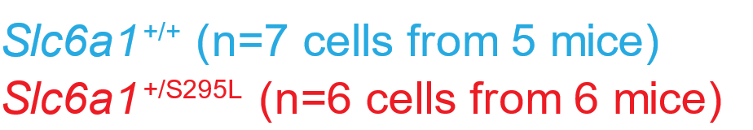
No Change in Tonic Current in Slc6a1^{+/S295L} Thalamus
Average Tonic Current
Graphs show mean with SEM with t-tests.

Slide 18
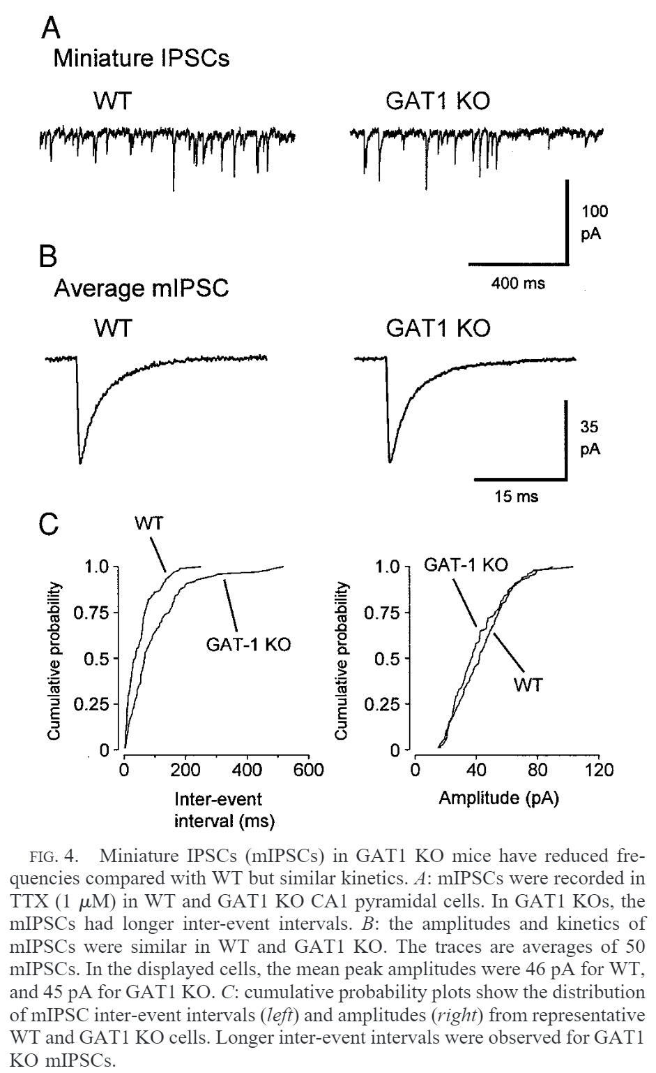
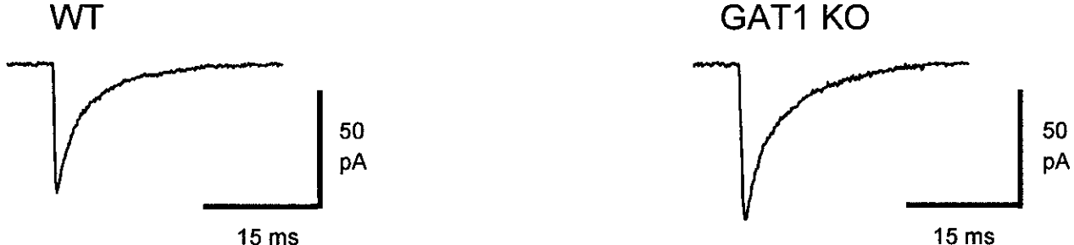
Synaptic GABAergic Currents in Slc6a1 KO Often Appear Normal
Decreased Frequency of mIPSCs, Normal Kinetics
Hippocampal CA1 pyramidal neurons in P15-25 Mice
Jensen et al, 2003 (Mody)
No Changes in sIPSCs
Hippocampal CA1 pyramidal neurons in P15-25 Mice
Jensen et al, 2003 (Mody)
No Changes in sIPSCs
Layer 3 cortical pyramidal neurons, 1-4 month old mice
Bragina et al, 2008 (Cherubini and Conti)

Slide 19
Increased Evoked IPSC Decay in Slc6a1 KO
Decreased Frequency of mIPSCs, Normal Kinetics
Hippocampal CA1 pyramidal neurons in P15-25 Mice
Jensen et al, 2003 (Mody)
Prolonged Decay of Evoked IPSCs
No Changes in sIPSCs
Hippocampal CA1 pyramidal neurons in P15-25 Mice
Jensen et al, 2003 (Mody)
No Changes in sIPSCs
Layer 3 cortical pyramidal neurons, 1-4 month old mice
Layer 3 cortical pyramidal neurons, 1-4 month old mice
Bragina et al, 2008 (Cherubini and Conti)
Bragina et al, 2008 (Cherubini and Conti)

Slide 20
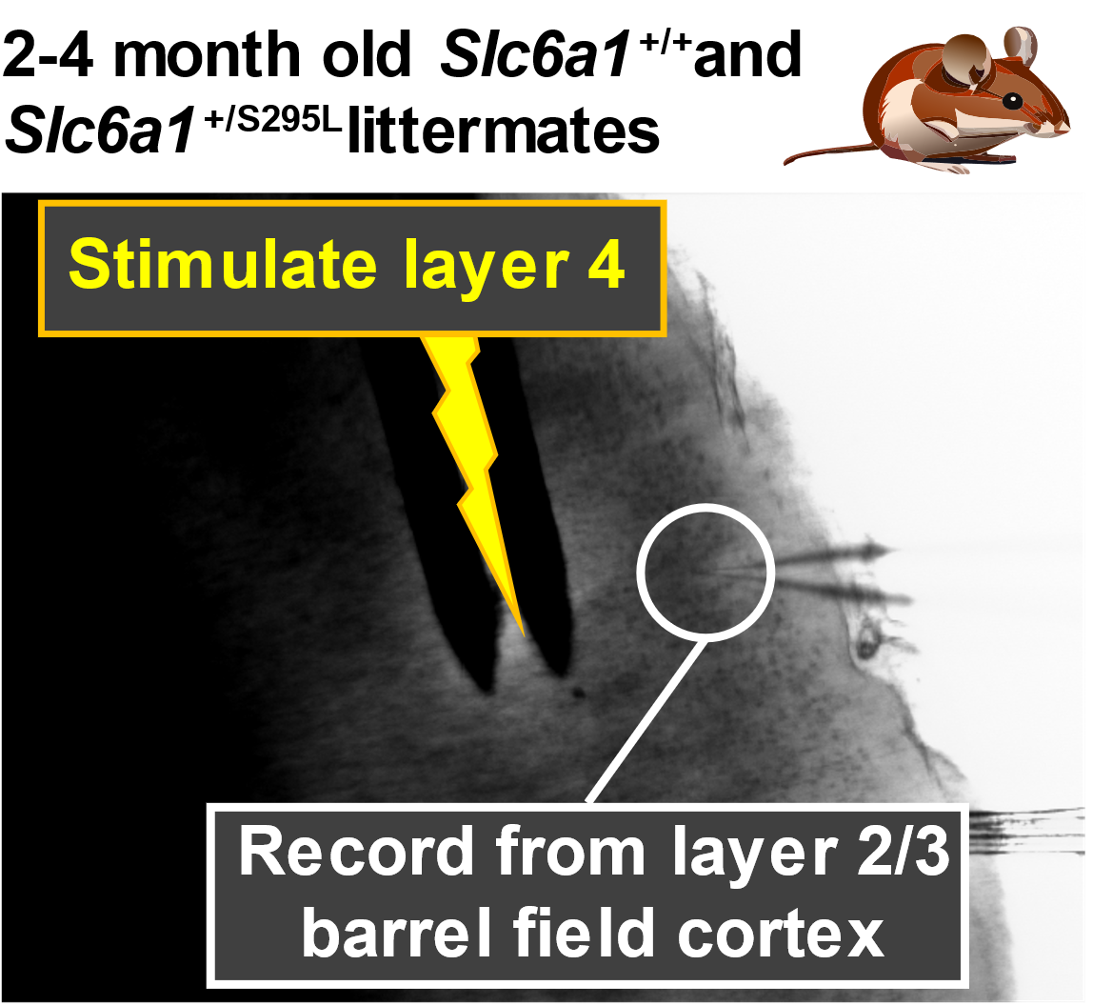
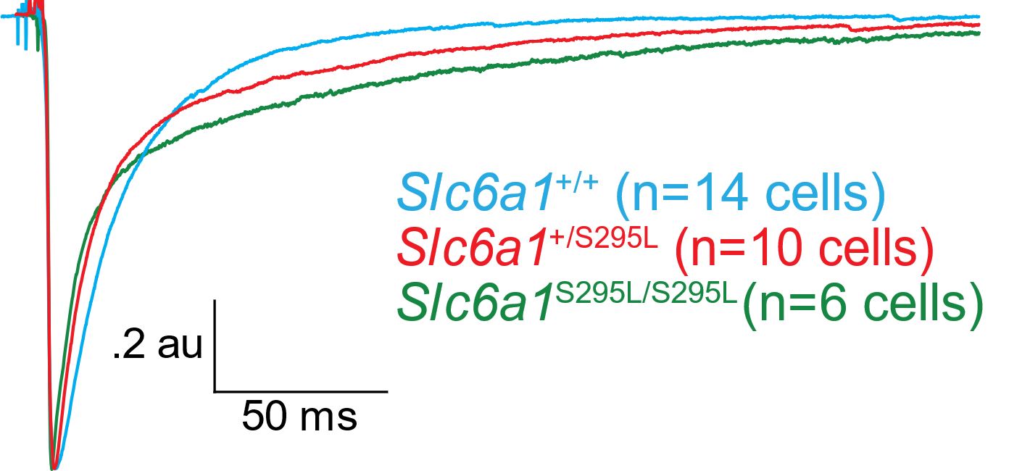
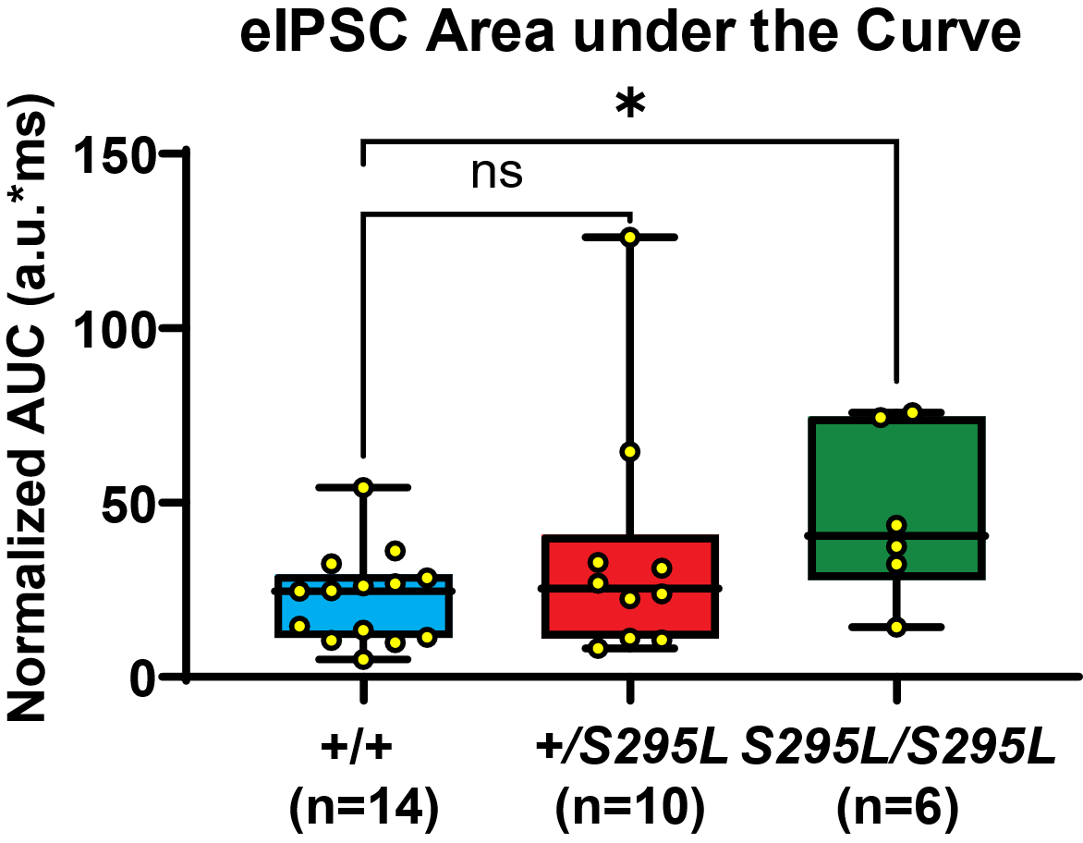
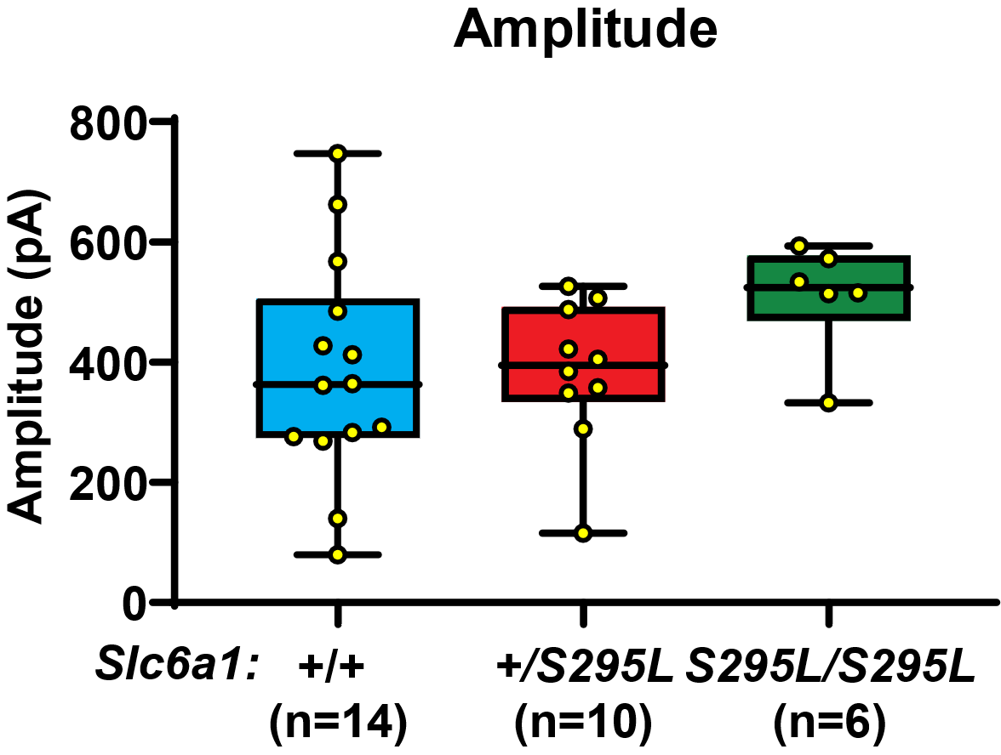
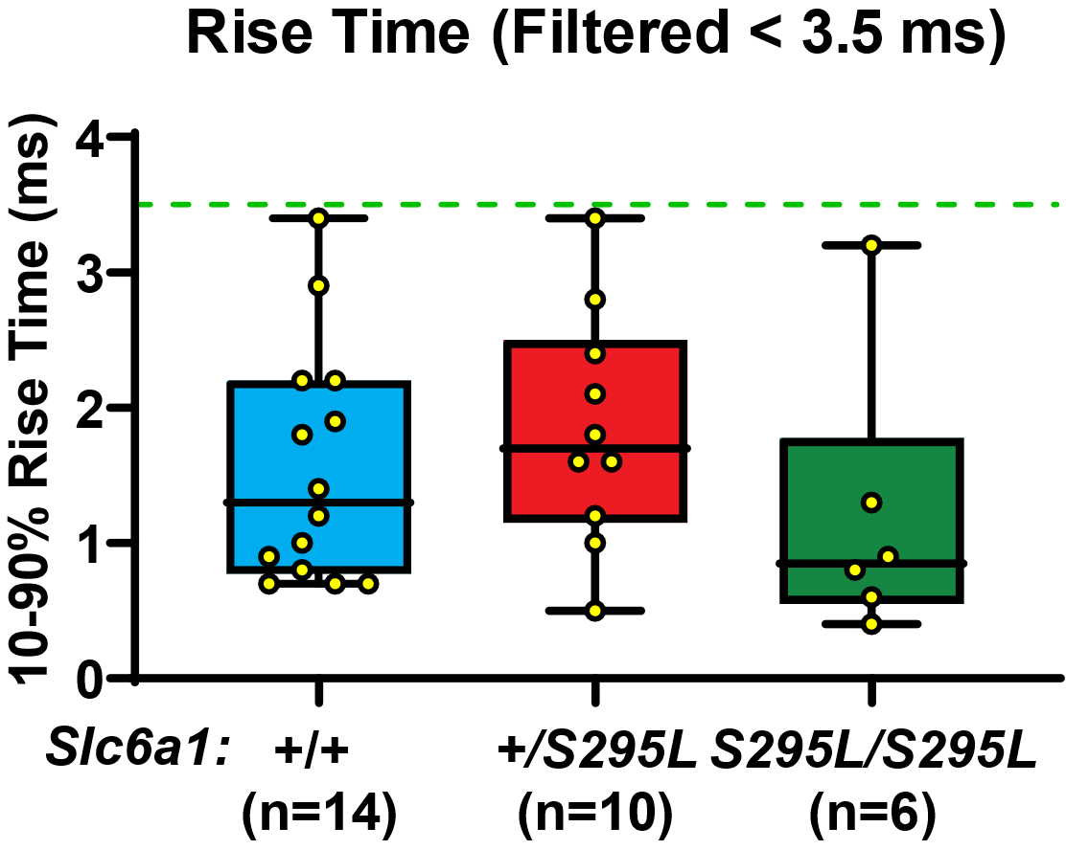
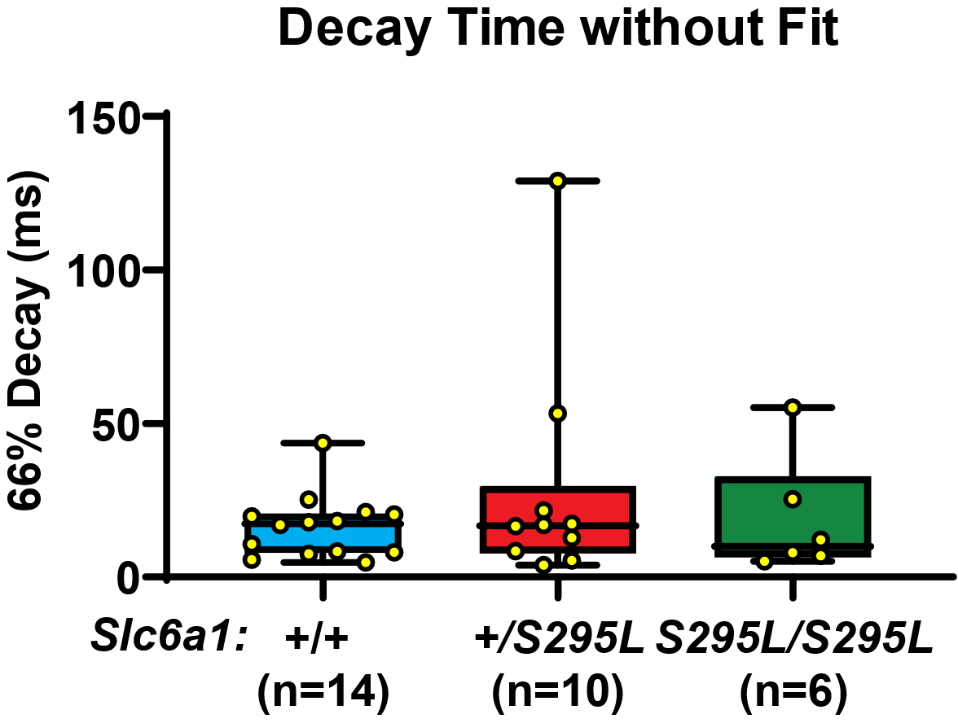
Prolonged eIPSCs in Slc6a1^{+/S295L} Mice
Plots show medians with maximum and minimum with Kruskal-Wallis test with Dunn’s multiple comparisons. *P<.05.

Slide 21
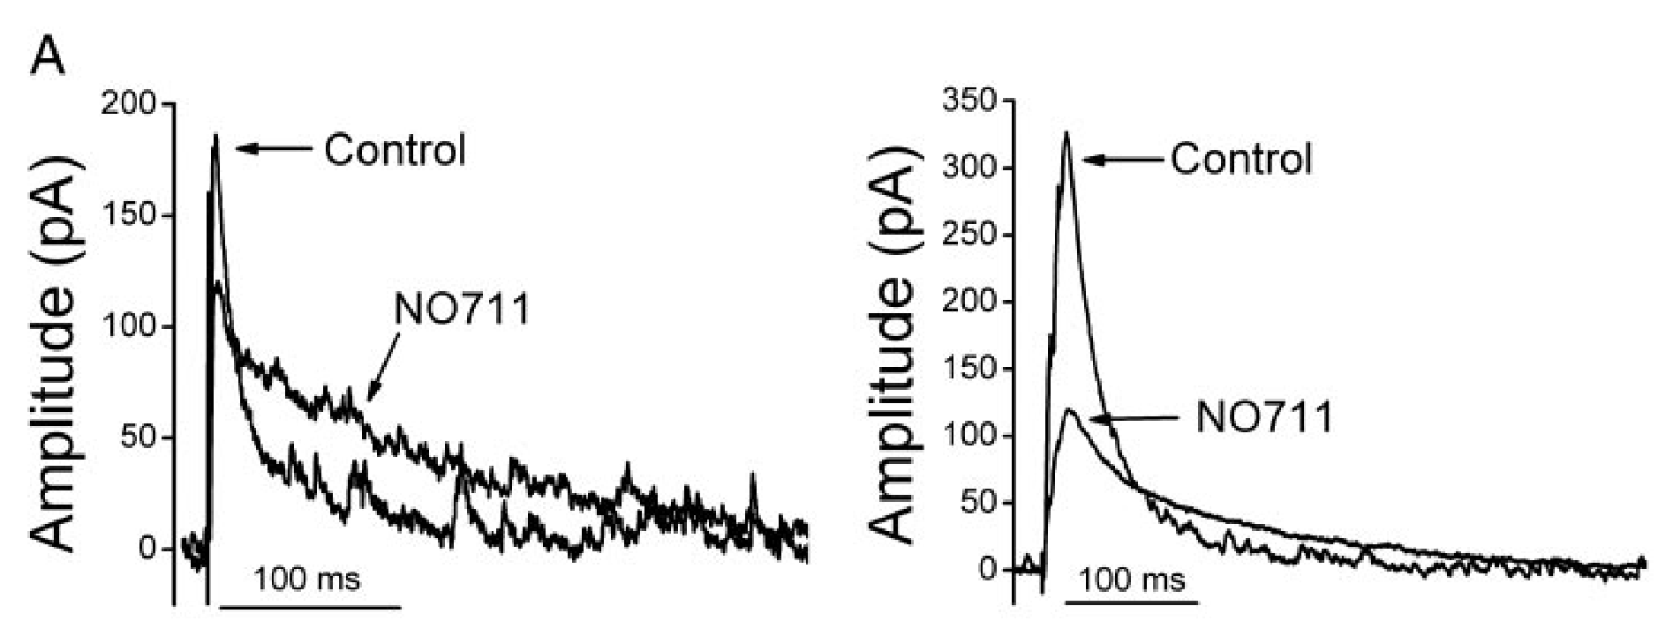
Prolonged Decay of eIPSCs with GAT-1 Antagonist NO711 Application
IPSCs evoked in layer 2/3 sensorimotor cortex by layer 1 stimulation
Keros and Hablitz, 2005

Slide 22
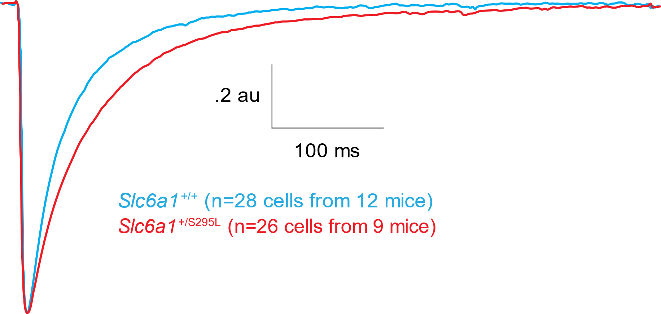
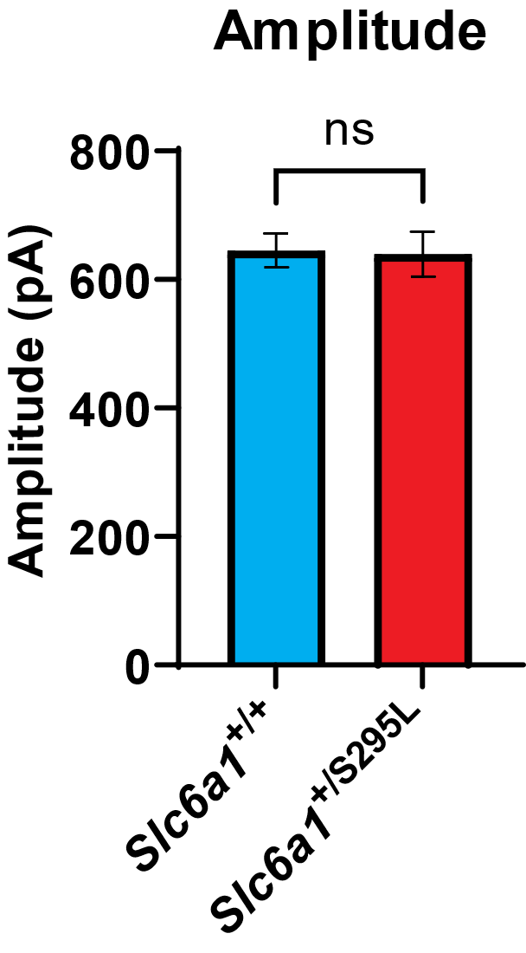
Prolonged eIPSC Decay in Slc6a1^{+/S295L} Mice
Average Evoked IPSC (Normalized)
For amplitude, means with SEM with t-test is shown. For medians, medians with IQR with Kruskal-Wallis test with Dunn’s multiple comparisons**P<.001, .01.

Slide 23
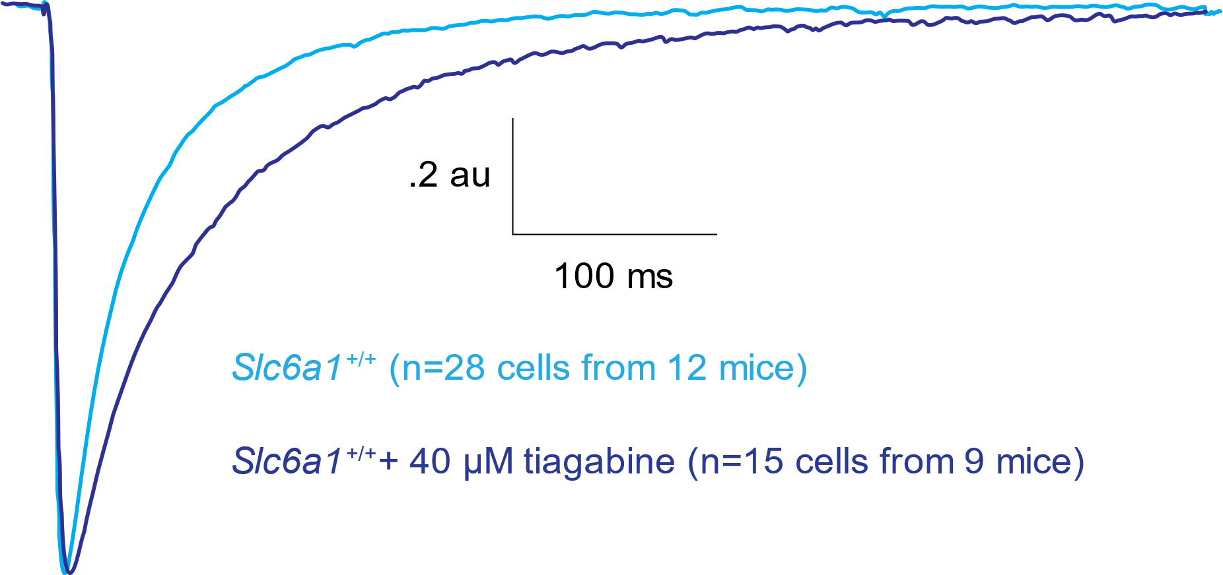
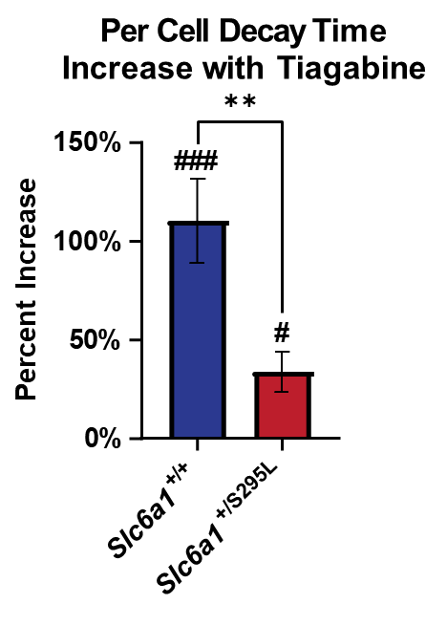
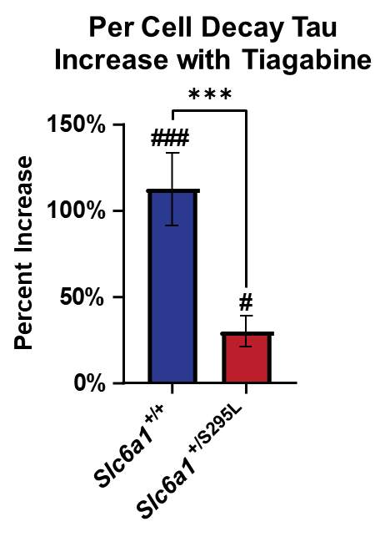
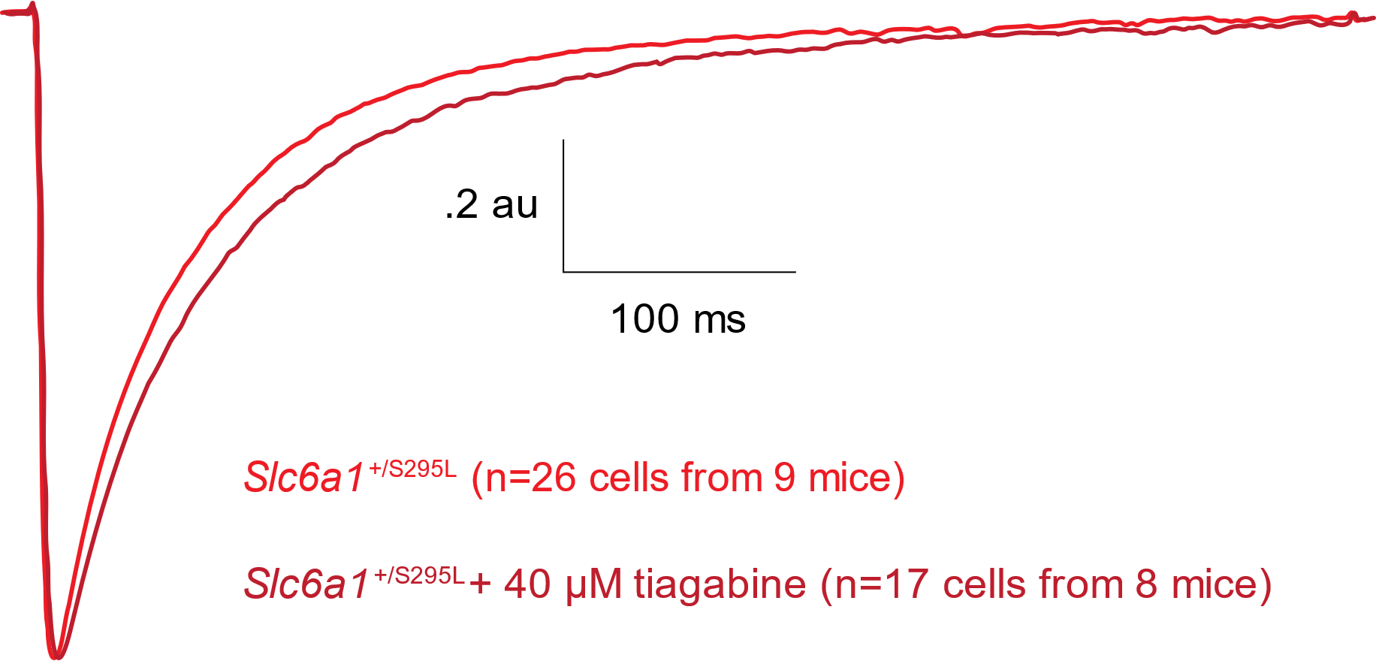
Tiagabine Prolonged eIPSC Decay Strongly in Slc6a1^{+/+} Mice, Weakly in Slc6a1^{+/S295L} Mice
Per Cell Rise Time Increase with Tiagabine
ns
Average Evoked Slc6a1^{+/+} IPSC (Normalized)
50%
40%
#
Percent Increase
30%
20%
10%
0%
ns
+/+
+/S295L
Slc6a1
Slc6a1
Average Evoked Slc6a1^{+/S295L} IPSC (Normalized)
Amplitude Change with Tiagabine
% of Amplitude before Tiagabine Washon
150%
ns
Tiagabine – GAT-1 blocker
###P<.0005, #P<.025 change with tiagabine vs without tiagabine by paired comparisons t-test (with Bonferroni adjustment)
Bar graphs represent means with SEM with t-tests ***,**P<.001, .01.
ns
ns
100%
50%
0%
+/+
+/S295L
Per Cell Decay Time Increase with Tiagabine
✱✱
Per Cell Decay Tau Increase with Tiagabine
✱✱✱
###P<.0005, #P<.025 change with tiagabine vs without tiagabine by paired comparisons t-test (with Bonferroni adjustment)
For each cell, an average eIPSC trace was calculated, from which metrics were calculated. Bar graphs represent means with SEM with t-tests or ANOVA with Sidak’s posthoc except where medians are noted. For medians, the data did not pass a normality test, and bar graphs represent medians with IQR with Kruskal-Wallis test with Dunn’s multiple comparisons. ***,**P<.001, .01.
Slc6a1
Slc6a1
150%
###
150%
###
Percent Increase
Percent Increase
100%
100%
50%
#
50%
#
0%
0%
+/+
+/S295L
+/+
+/S295L
Slc6a1
Slc6a1
Slc6a1
Slc6a1

Slide 24
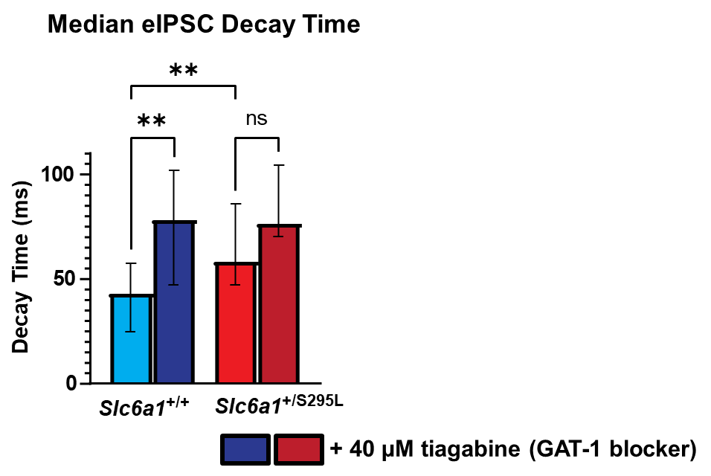
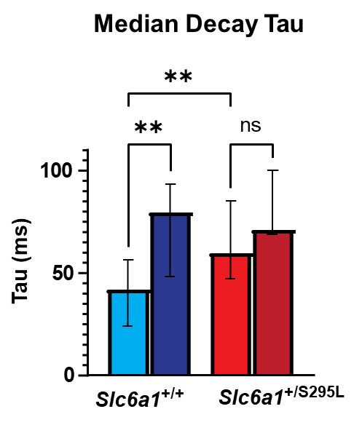
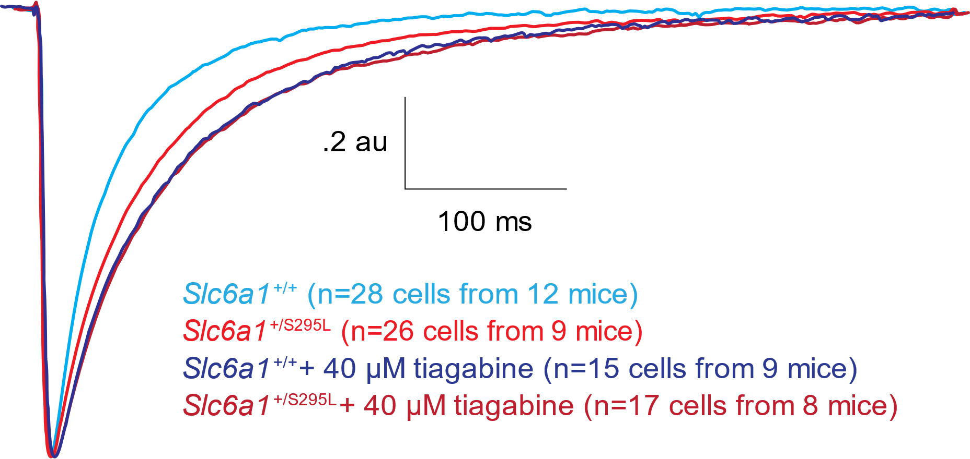
Tiagabine Prolonged eIPSC Decay Strongly in Slc6a1^{+/+} Mice, Weakly in Slc6a1^{+/S295L} Mice
Average Evoked IPSC (Normalized)
Median Decay Tau
✱✱
✱✱
ns
100
Tau (ms)
50
0
_{Slc6a1}+/S295L
Slc6a1^{+/+}
Bar graphs represent medians with IQR with Kruskal-Wallis test with Dunn’s multiple comparisons. **P< .01.
Median eIPSC Decay Time
✱✱
✱✱
ns
100
Decay Time (ms)
50
0
_{Slc6a1}+/S295L
Slc6a1^{+/+}
+ 40 µM tiagabine (GAT-1 blocker)

Slide 25
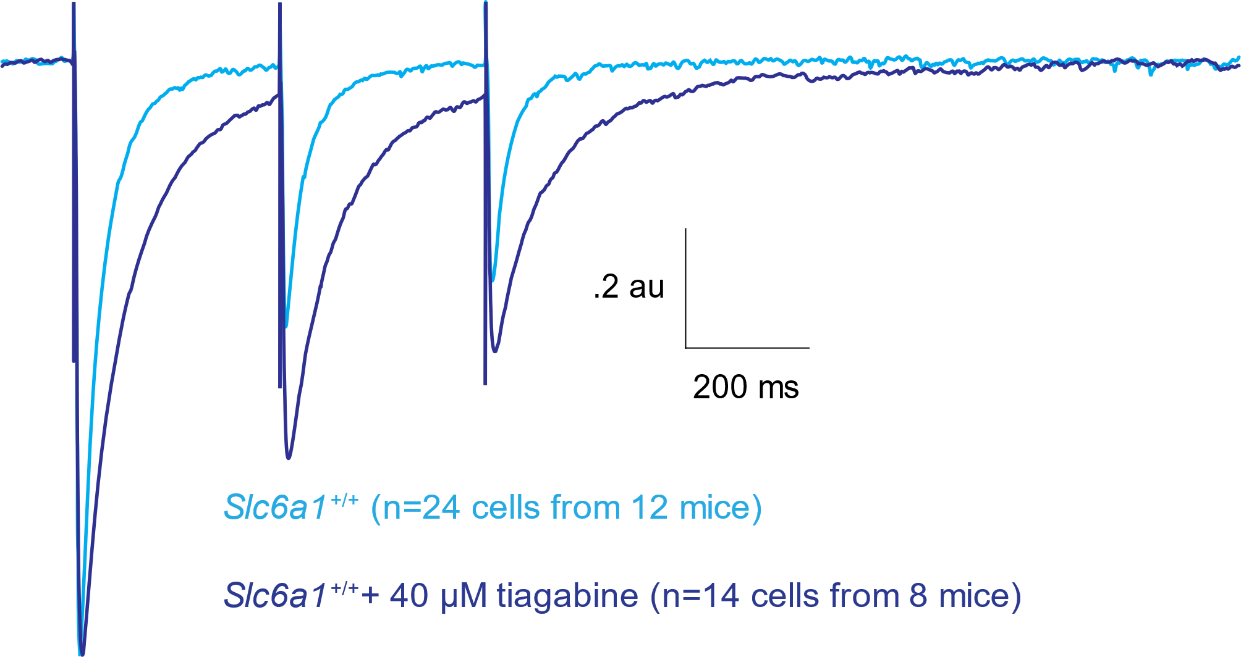


Tiagabine Increases Amplitude of Successive eIPSCs
Average Evoked Slc6a1^{+/+} IPSC (Normalized)
Average Evoked IPSC (Normalized)
Slc6a1^{+/+} + 40 uM tiagabine (GAT-1 blocker)
Amplitude change shown as mean with SEM with ANOVA with Sidak’s posthoc. ***, *P< .001, .05.

Slide 26


Tiabagine Increases Successive eIPSC Amplitude
in Slc6a1^{+/+} and Slc6a1^{+/S295L} Mice
Average Evoked IPSC (Normalized)
Average Evoked IPSC (Normalized) + Tiagabine
Amplitude change shown as mean with SEM with ANOVA with Sidak’s posthoc. ***, *P< .001, .05.
Amplitudes were normalized to the first eIPSC of each trace, and are shown as mean with SEM with ANOVA with Sidak’s posthoc. Rise time and decay are shown as medians with IQR with Kruskal-Wallis test (unpaired) or Friedman test (paired) with Dunn’s multiple comparisons. ****,***,**,*P<.0001, .001, .01, .05.

Slide 27




Successive IPSCs Show Prolonged Decay with Tiagabine and in Slc6a1^{+/S295L} Mice
Average Evoked Slc6a1^{+/+} IPSC (Normalized)
Average Evoked IPSC (Normalized)
Decay shown as medians with IQR with Kruskal-Wallis test (unpaired) or Friedman test (paired) with Dunn’s multiple comparisons. ****,***,**,*P<.0001, .001, .01, .05.

Slide 28



Tiagabine Weakly Prolongs Decay of Successive eIPSCs in Slc6a1^{+/S295L} Mice
Average Evoked Slc6a1^{+/S295L} IPSC (Normalized)
Average Evoked IPSC (Normalized) + Tiagabine
Decay shown as medians with IQR with Friedman test (paired) with Dunn’s multiple comparisons.**P<.01.

Slide 29






Prolonged Decay of Spontaneous IPSCs in Slc6a1^{+/S295L}
Bar graphs show mean with SEM with t-tests for amplitude and decay (normal distribution), rise time and interevent interval are shown as medians with IQR with Mann-Whitney test (fail normality test).

Slide 30






Prolonged Decay and Other Changes in Spontaneous IPSCs in Slc6a1^{S295L/S295L}
Bar graphs show mean with SEM with t-tests (normal distribution), interevent interval is shown as medians with IQR with Mann-Whitney test (fail normality test).

Slide 31

Summary

Slide 32

Thank You! Questions?
Kang Lab
Jing-Qiong Kang
Kirill Zavalin
Karishma Randhave
Melissa Bassett-Deleuw
Wangzhen Shen
Undergraduate Students
Ziang Song
Rishi Pillai
Ekta Anand
Elijah Simon
Eliam Chang
Vanderbilt University Medical Center
Department of Neurology

Slide 33

Tiagabine Increases Rise Time of eIPSCs
Average Evoked IPSC (Normalized)
Rise times shown as medians with IQR with Kruskal-Wallis test (unpaired) or Friedman test (paired) with Dunn’s multiple comparisons. ***,**,*P<.001, .01, .05.

Slide 34
Average Evoked Slc6a1^{+/+} IPSC (Normalized)
Decay shown as medians with IQR with Friedman test (paired) with Dunn’s multiple comparisons. ****,***,**,*P<.0001, .001, .01, .05.
Average Evoked Slc6a1^{+/S295L} IPSC (Normalized)

Slide 35
Trend for Reduced GABA Uptake in Cortex and Cerebellum
Graph shows mean with SEM with paired t-tests with Bonferroni corrections.

Slide 36

What Are the Pathologic Changes in GABAergic Neurotransmission with SLC6A1(S295L) DEE?
SLC6A1(S295L)
Normal

Slide 37
What Are the Pathologic Changes in GABAergic Neurotransmission with SLC6A1(S295L) DEE?
SLC6A1(S295L)

Slide 38


Reduced GAT-1 Expression in Slc6a1^{+/A288V} and Slc6a1^{+/S295L} Mice
Reduced GAT-1 Expression in Slc6a1^{A288V} Mice
Normalized GAT-1 Protein in Slc6a1^{A288V} Mice
Partial LOF
WT: Slc6a1^{+/+}, HT: Slc6a1^{+/A288V}, HM: Slc6a1^{A288V/A288V}
Reduced GAT-1 Expression in Slc6a1^{S295L} Mice
Normalized GAT-1 Protein in Slc6a1^{S295L} Mice
Complete LOF
Work of Dr. Wangzhen Shen
WT: Slc6a1^{+/+}, HT: Slc6a1^{+/S295L}, HM: Slc6a1^{S295L/S295L}
Notes:
Add partial LOF, complete LOF

Slide 39




Reduced Surface GAT-1 Expression in Slc6a1^{A288V/+} and Slc6a1^{S295L/+} Mice
Reduced Surface GAT-1 Expression in Slc6a1^{A288V/+} Mice
Normalized Surface GAT-1 Protein in Slc6a1^{A288V/+} Mice
Normalized Surface GAT-1 Protein in Slc6a1^{A288V/+} Mice
WT: Slc6a1^{+/+}, HT: Slc6a1^{A288V/+}, HM: Slc6a1^{A288V/A288V}
**
*
**
**
Reduced Surface GAT-1 Expression in Slc6a1^{A288V/+} Mice
Reduced Surface GAT-1 Expression in Slc6a1^{S295L/+} Mice
Normalized Surface GAT-1 Protein in Slc6a1^{S295L/+} Mice
Slc6a1: +/+ A288V/+
U Ctx Cb Hip Thal Ctx Cb Hip Thal
100 kDa
ATPase
GAT1
WT: Slc6a1^{+/+}, HT: Slc6a1^{S295L/+}, HM: Slc6a1^{S295L/S295L}
WT Het WT Het WT Het WT Het
50 kDa
Work of Dr. Wangzhen Shen
^{Ctx}
^{Cb}
^{Hip}
^{Thal}
Approximately 1 month old male mice were used in this study. Ctx: cortex, Cb: cerebellum, Hip: hippocampus, Thal: thalamus, U: untransfected Chinese Hamster Ovary cell line control. ATPase was used as loading control. ***,**,*P<.001, .01, .05 vs WT by t-test, respectively.
Normalized Surface GAT-1 Protein in Slc6a1^{S295L/+} Mice
Reduced Surface GAT-1 Expression in Slc6a1^{S295L/+} Mice
Scl6a1: +/+ S295L/+
***
**
***
***
U Ctx Cb Hip Thal Ctx Cb Hip Thal
100 kDa
ATPase
GAT1
50 kDa
WT Het WT Het WT Het WT Het
^{Ctx}
^{Cb}
^{Hip}
^{Thal}

Slide 40


Slide 41
Average Evoked IPSC (Normalized)
Average Evoked IPSC (Normalized) + Tiagabine

